Slide 1

Scaled Wind Farm Technology (SWiFT) Facility
A Sandia National Labs Wind Energy and Microgrid User Research Facility

Slide 2
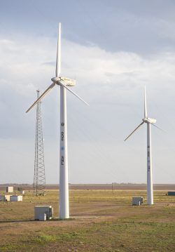



What is SWiFT?
Enabling rapid, cost-effective research to improve wind plant performance and advance technology.
First public facility to use multiple wind turbines to measure turbine performance in a wind farm environment.
SWiFT partners with industry and academia to:
Reduce turbine-to-turbine interaction and wind plant underperformance
Develop advanced wind turbine rotors
Virtual Tour: tours.sandia.gov/SWIFT/
Website: energy.sandia.gov/SWIFT
Improve the validity of advanced simulation models

Slide 3
Why are we here today?

Slide 4
Facility Details
A Sandia National Labs premiere Wind Energy and Microgrid User Research Facility

Slide 5
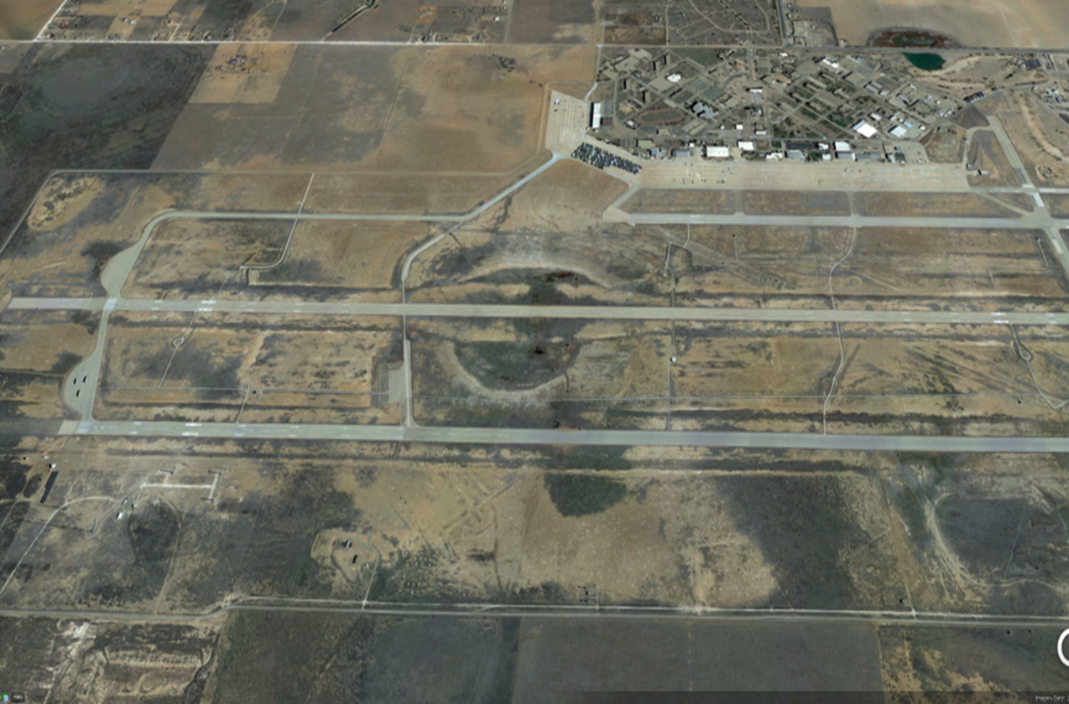
Well-suited Wind Research Location
The SWiFT Facility, a premiere wind research test facility, is located on a secure and unobstructed location, the Reese Technology Center (formerly Reese Air Force Base).
Reese Technology Center
Lubbock, TX
Courtesy Texas Tech University
7.5 m/s at 50 m, Class 5 wind site with consistent south wind, 180.5°average
SWiFT Facility Turbine Field Site
SWiFT Facility Building 350
Courtesy National Renewable Energy Laboratory

Slide 6
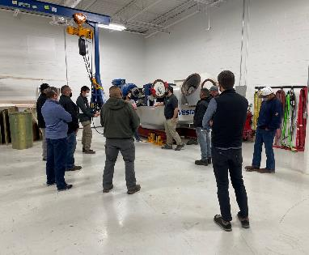
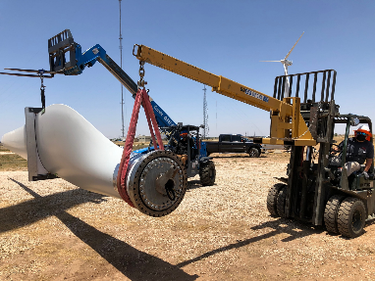
Rapidly and Economically evaluate open wind energy research questions
4,500 sq. ft. environmentally controlled high-bay experimental rotor preparation
1,000 sq. ft. machine shop
Highly experienced and passionate technologists, engineers, support subject matter experts, and research partners
Reachback into vast Sandia subject matter expert resources
Equipment
&
Facilities
Technical Capabilities
Three variable-speed 300-kW variable-pitch modified wind turbines with full power conversion
Complete turbine / rotor state instrumentation
Two 80m meteorological towers equipped with cup and sonic anemometers
Open source controller
700 sq. ft. turbine control building with full SCADA visibility
Partnership with Texas Tech’s National Wind Institute (NWI) provides access to NWI’s state-of-the-art observational facility, including the 101-station West Texas Mesonet, a regional Sonic Detection and Ranging (SODAR) network, two mobile Doppler radars, and the DOE-X radar prototype.

Slide 7
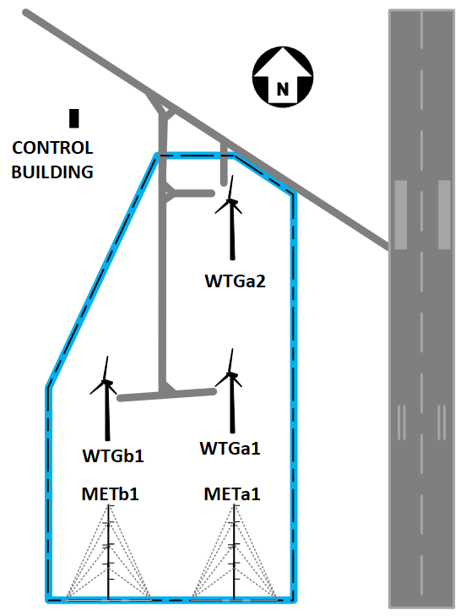
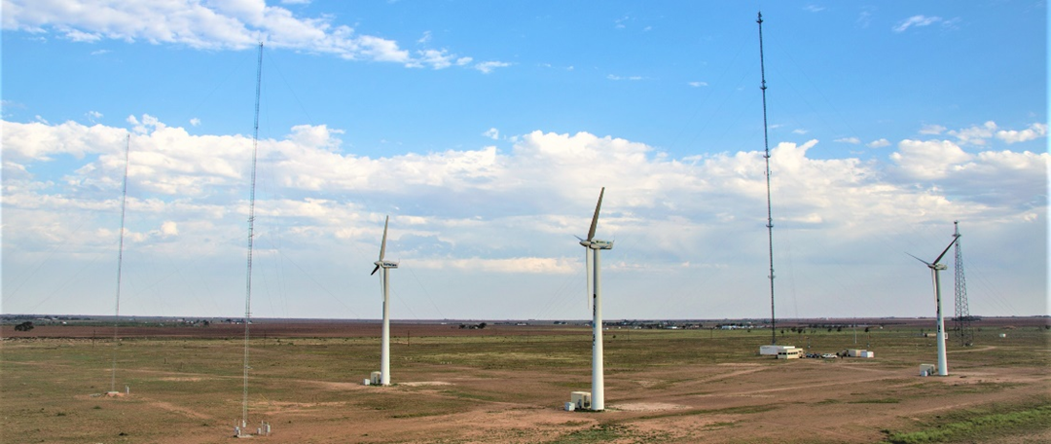
Cost Effective Research Capabilities
Compared to Full-scale Turbines:
Turbines are smaller than most utility-scale turbines
Blades and molds are less expensive
Crane scheduling is faster and cheaper
Risk of failure is substantially lower
The site’s triangular layout allows both side-by-side comparison of performance and turbine-to-turbine interaction in complex wake flows.

Slide 8
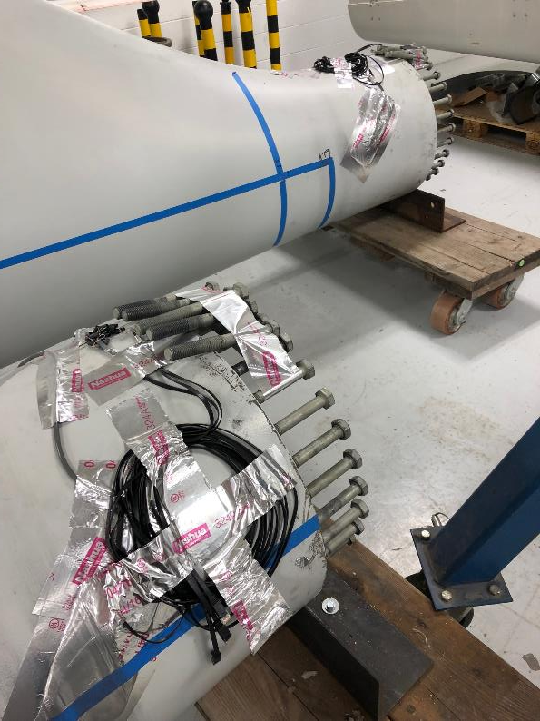
Instrumentation
Large array of turbine and met tower sensors to which to calibrate or validate instruments
Control and treatment setup of turbine/met tower pairs is ideal for validations
Staff and subject matter experts with vast and deep experience with meteorological instruments
Anemometers, lidars, tethersondes, radiosondes, etc.
Turbine instrumentation
Strain gauges (foil and FBG), IMUs, accelerometers, etc.
Instruments can potentially be integrated into turbine controls
On site shop for custom rigging/mounting

Slide 9
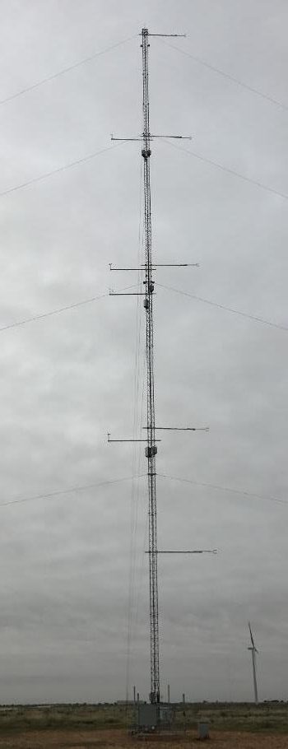
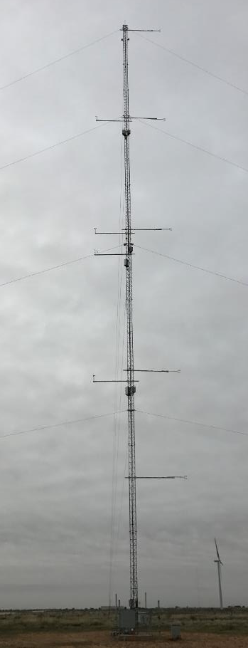
Wind Measurement
Environmental Measurement
Cup Anemometer
Meteorological Tower
Humidity
3D Sonic Anemometer
Wind Vane
Pressure
Temperature

Slide 10
Doing Research at the Reese Technology Center
Secure access and research on the former Reese Air Force Base
Sandia staff possess security clearances enabling cyber and other secure research
Reese is an independently governed entity of the State of Texas, making for streamlined research setup and tie-in to power and communication infrastructure
Partnership with Group NIRE brings in expertise in development and power share agreements

Slide 11
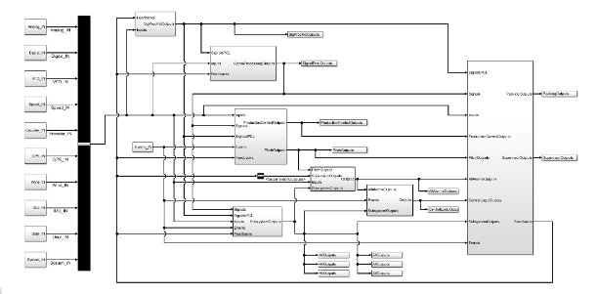
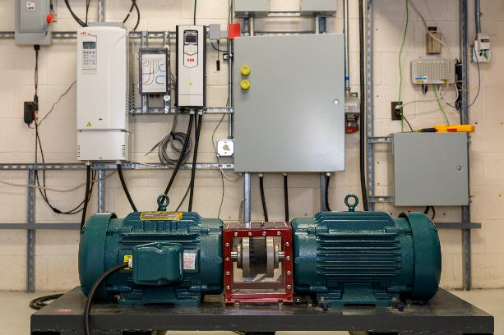
Turbine-turbine and Plant-level Control Strategies
Fully accessible open-source controller
  Programmed in MATLAB/Simulink
  Compiled to run on Bachmann M200 series or NI CompactRIO
  Can be modified for any controller logic and add new capabilities
  Combine information from multiple systems for plant-level control
Three turbines placed for wake interaction and wind plant flow measurement and model validation
Research signals
  Stock V27 signals including blade pitch and rotor speed
  ADDED Rotor azimuth angle, Yaw heading, Tower bending moment, Nacelle acceleration, and rotation rate
Data acquisition time-synchronization
  System times are synched to site time-server using NTP
  Time stamps from localized GPS sources are available
Wind Turbine Emulator
  Supports rapid software development, software validation, and power-hardware-in-the-loop testing
  Full duplicate of controller hardware, power converter (variable frequency drive), and generator at 10kW scale

Slide 12
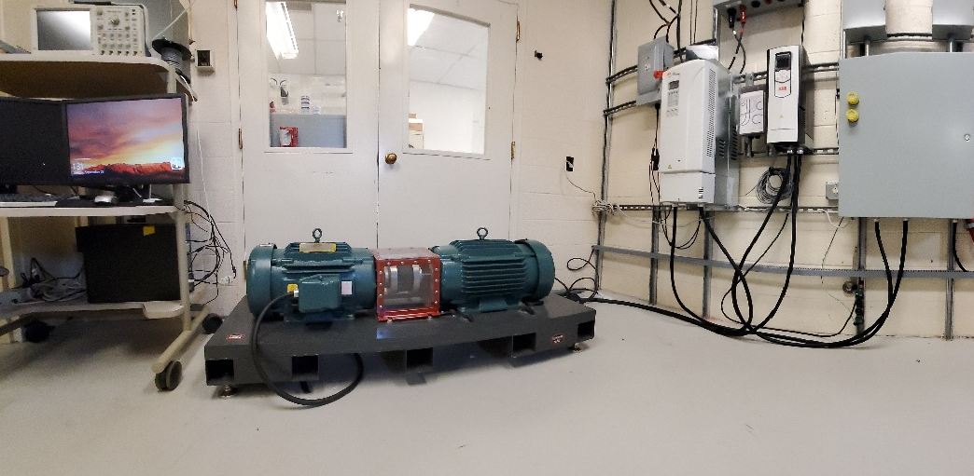
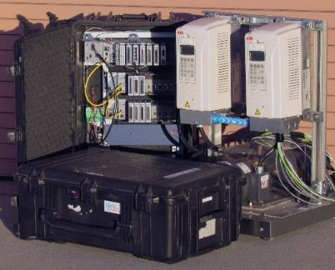
Performance and Interaction of Hybrid Systems in a Microgrid Environment
The wind turbine emulator, consists of a scaled-down wind turbine motor and uses much of the same hardware and software that control actual turbines.
A regenerative power converter serves as the device under test. For the mechanical component of the wind turbine emulator, two 20 hp 1,765 RPM motors/generators are used.
A non-regenerative Motor Drive is used to control the torque input motor which is programmed to emulate the torque effects the wind has on the wind turbine generator shaft.
Wind Turbine
Emulator Controller Computer
Power
Converter
Torque
Input Motor
Motor
Drive
Data Measurement and Acquisition
Generator
J. C. Berg, B. T. Naughton, and R. Darbali-Zamora, “Distributed Energy Technology Laboratory Wind Turbine Emulator Design Documentation”, SANDIA REPORT, SAND2022-16344, Nov. 2022.
Sandia National Laboratories Wind Turbine Emulator Power Hardware in the Loop Platform and SWiFT Controller located in the Distributed Energy Technology Laboratory (DETL).
SWiFT Wind Turbine Controller

Slide 13
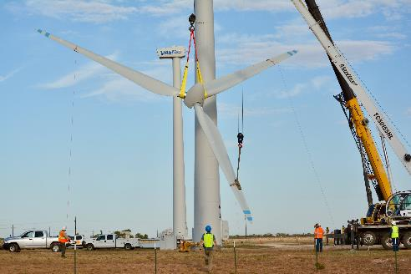
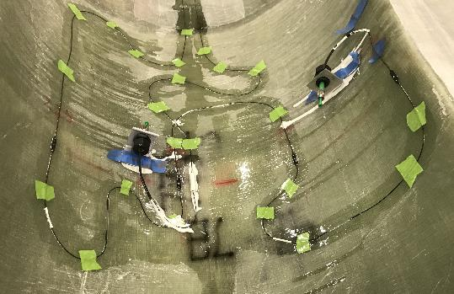
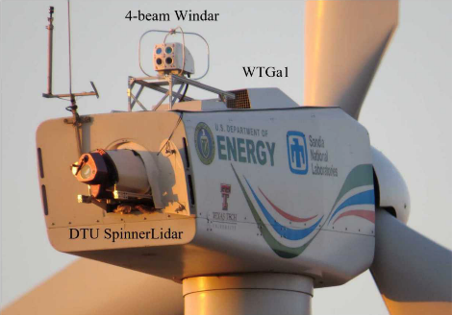
Prototype and Technology Demonstrations
Demonstrate wind turbine technology including blade prototypes, remote sensing, and active aerodynamics
Open and modifiable turbine controller
On blade sensors, hub data acquisition, and wake measurements to support validation of turbine models
Expertise with scaled results, relevant to Megawatt turbines
High wind resource in Texas Panhandle
New NRT blades being installed at SWiFT, manufactured in 3D printed molds, and used for scaled wake and turbine interaction research
Expertise with fiber optic strain measurements in prototype blades
Advanced lidar and remote sensing instruments deployed in Wake Steering experiment

Slide 14
Prototype and Demonstrate Low TRL Technologies
SWiFT fills a critical need for field data to support modeling and overall testing
The SWiFT facility offers cutting edge wind characterization
The skill of models to characterize the lower atmosphere (verification/validation) needs to be assessed, and measuring the atmospheric flows and the turbulence (4D) down to sub-meter scales is very challenging
SWiFT is well suited to serve the purpose of measuring the atmosphere at scales important to wind power, particularly over flat terrain
Location in Texas Panhandle is excellent, with consistent wind, flat terrain.
Field measurements of wind turbine performance are rarely public domain and yet crucial to the development and testing of tools and models. These measurements can be made at the SWiFT facility with all the relevance of modern wind farms, but at a substantially lower cost.

Slide 15
Cybersecurity
Plant-level control architecture can be adapted to cybersecurity research and testing needs
The turbines can be connected into a nearby microgrid operated by Texas Tech University and Group NIRE that contains PV, Battery, and Building energy systems
SWiFT-GLEAMM microgrid allows modeling, simulation, emulation, testing, and validation of control systems security and process simulations
SWiFT-GLEAMM microgrid allows researchers to process simulations, with control hardware in the loop, providing an integrated system capable of representing realistic responses in a physical process as events occur in the control system and vice versa
Wind turbine control logic is fully accessible and editable
  Controller hardware options include Bachmann M200 series, NI CompactRIO, or any hardware which supports compilation from MATLAB/Simulink
  Interfaces and communication protocols can be added as needed to support research goals
Wind Turbine Emulator hardware-in-the-loop system can be used to research turbine behavior accurately without the risk of physical damage. This could support such activities as risk quantification and consequence.

Slide 16
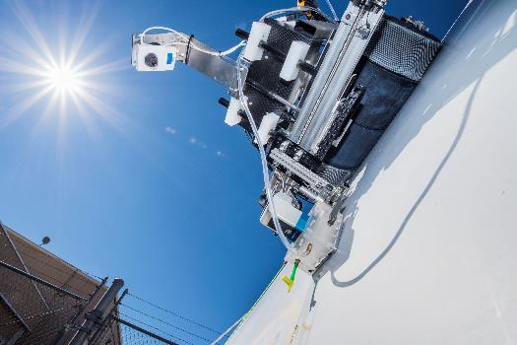
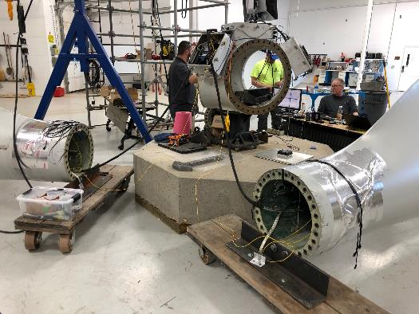
O&M Technologies and Strategies
O&M proving ground to field-test new technology before its deployed to wind farm scale
  Sensors
  Inspection methods
  Repair methods
  Data collection and structural health monitoring
  Robots & drones
Training facility to support O&M training on new technologies
  Inspection and repair
  Implementation of sensors, etc. to wind farm techs.
Streamlined data collection
  Access to public datasets
  Calibration of equipment
  Test data collection and outputs

Slide 17







Workforce Development & Partners in Research
SWiFT enables partnering with Sandia for educating the future renewable energy workforce through internships
Decade-long partnership with TTU National Wind Institute (NWI) wind engineering program
Partnership with South Plains College Industrial Manufacturing and Emerging Technologies (IMET) wind turbine technician training program
  Enables wind turbine technician internships to leverage hands-on application of concepts learned in the IMET Program
SWiFT assets and capabilities make consortium-level agreements very attractive for entities seeking a location for operations and maintenance training

Slide 18




TTU NWI 200m MET Tower
SWiFT MET Towers
SWiFT Wind Turbines
SWiFT Control Building
150 kW PV Array
500 kW Diesel GenSet
New capability following integration in early 2023 with the Texas Tech University Global Laboratory for Energy Asset Management and Manufacturing (GLEAMM) will enable microgrid research with multiple substations.
2 x 500 kW Load Bank

Slide 19
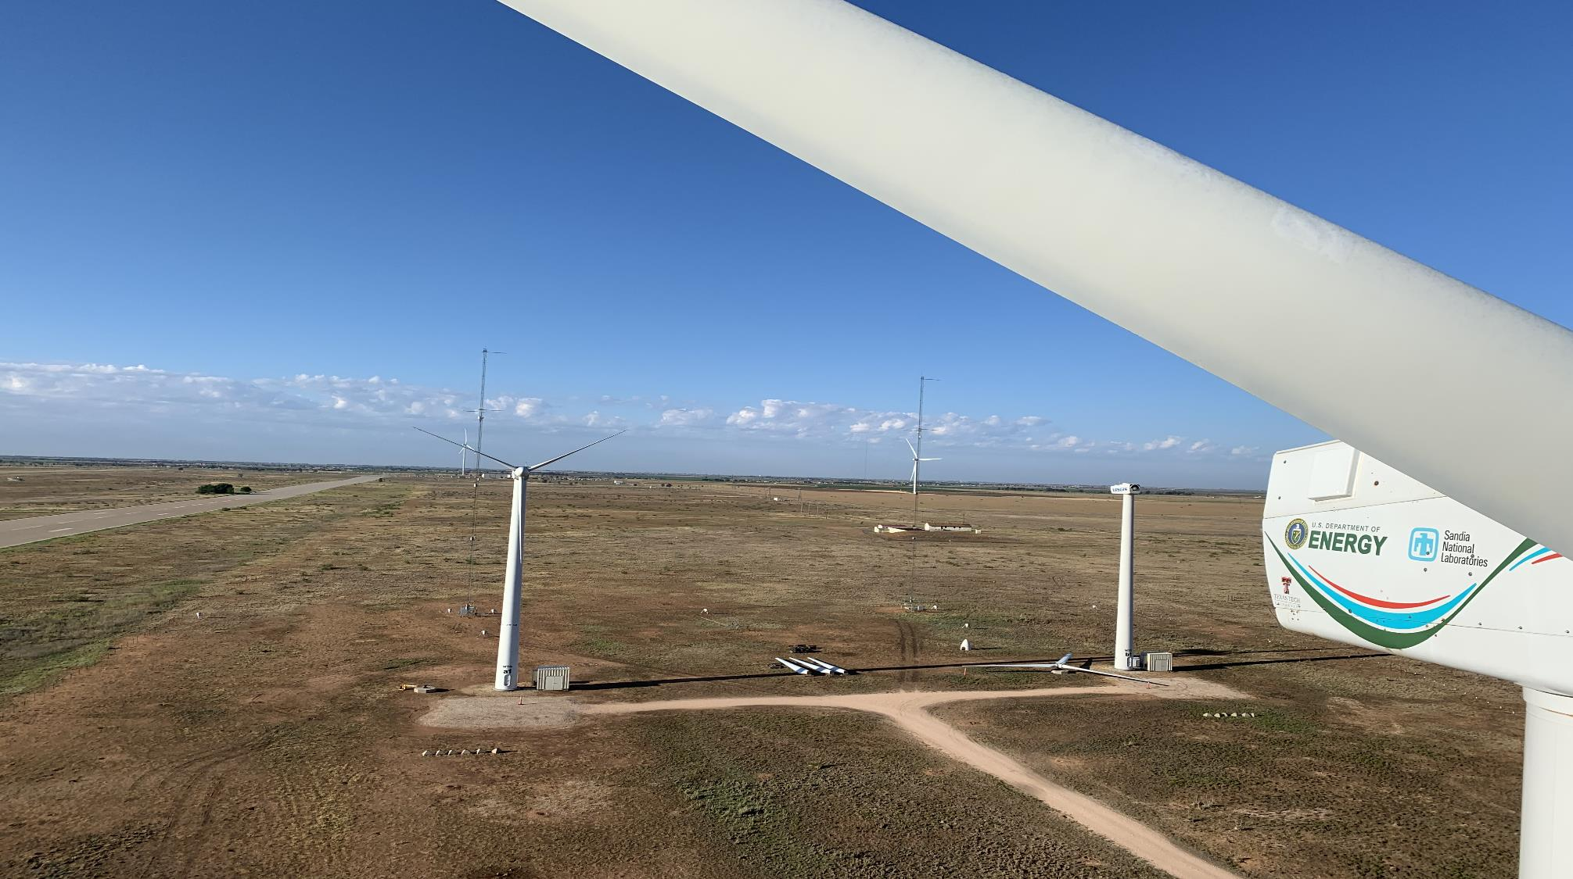


Scaled Wind Farm Technology (SWiFT) Facility Operated by Sandia National Labs
for the Department of Energy,
Wind Energy Technologies Office (WETO)
Contact:
Timothy G. (Tim) Riley, SWiFT Project Lead
+1 (505) 205-6433
tgriley@sandia.gov
https://energy.sandia.gov/programs/renewable-energy/wind-power/

