Slide 1
Sandia PV Systems Capabilities Areas Anthony Martino, Ph.D. Photovoltaics & Materials Technologies Sandia National Laboratories P.O. Box 5800, MS 0734 Albuquerque, NM 87185-0734 (505) 844-0652 martino@sandia.gov SAND2020-13339 PE

Slide 2
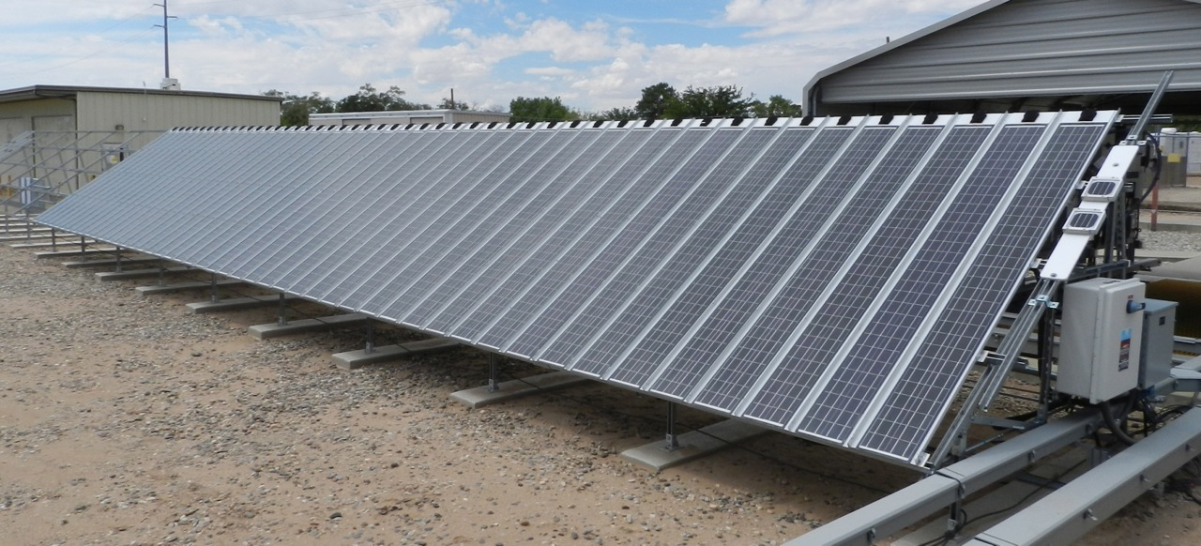
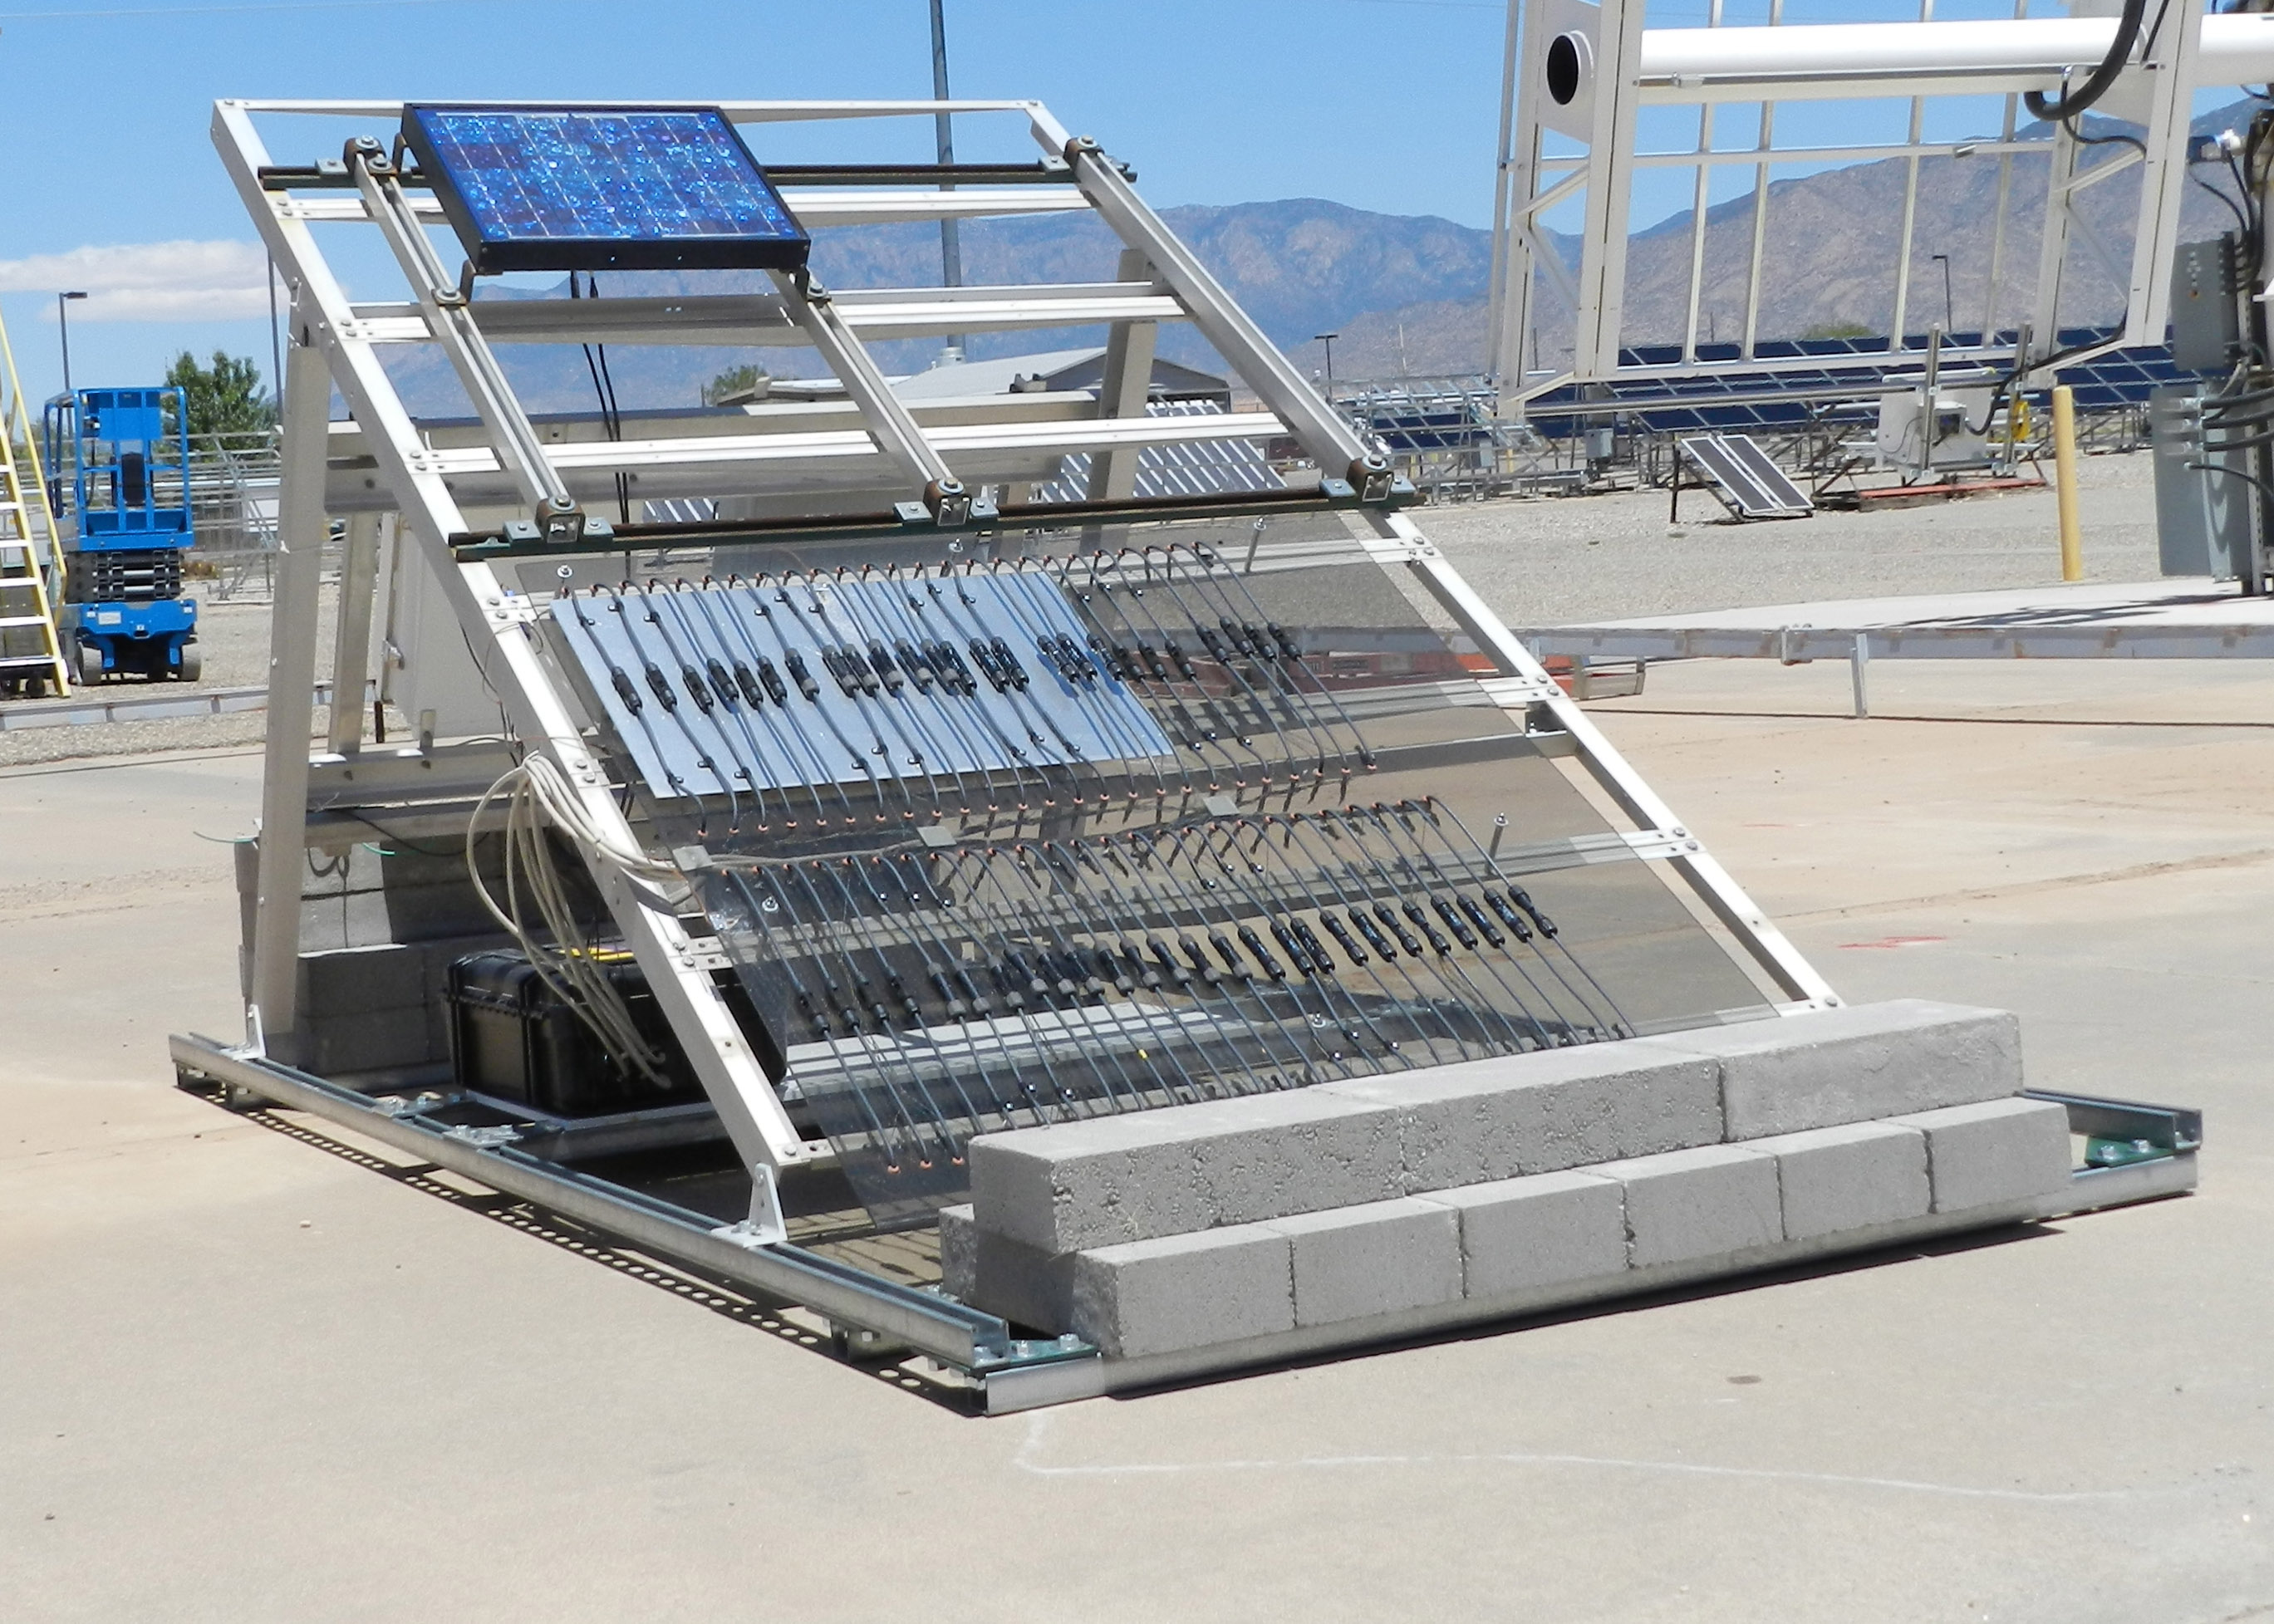
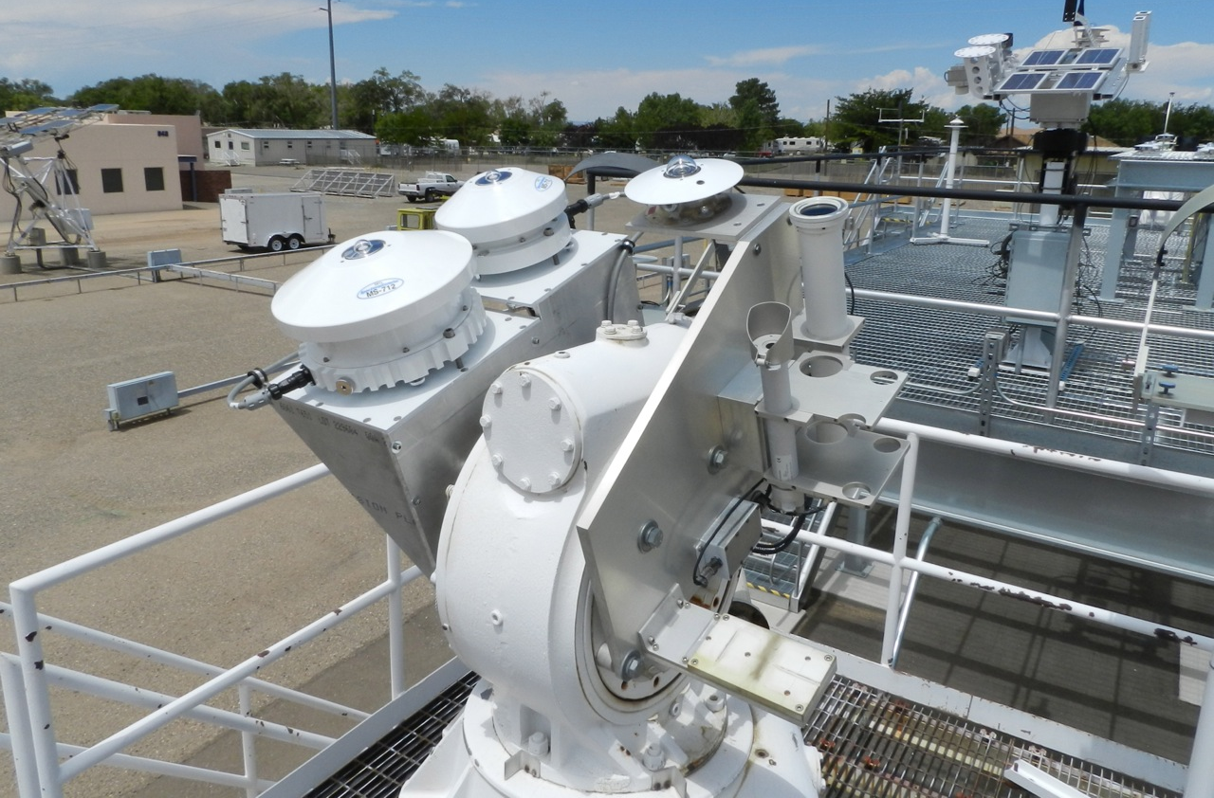
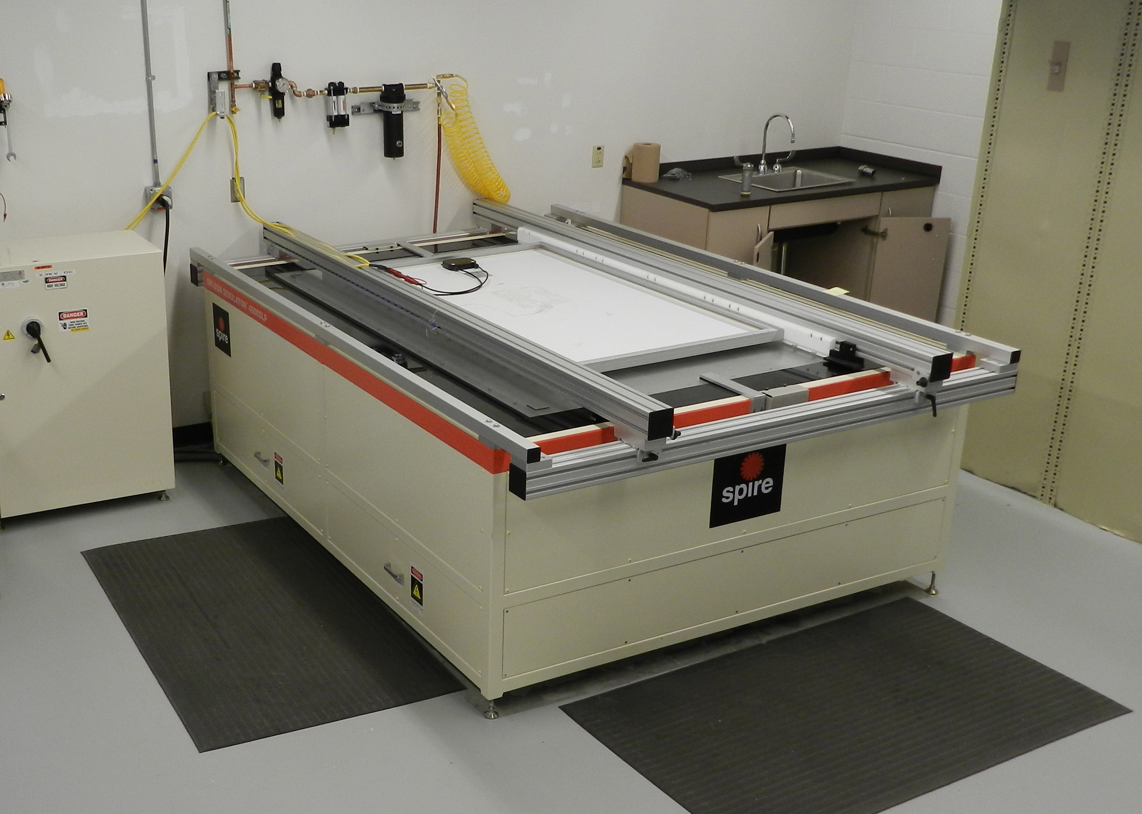
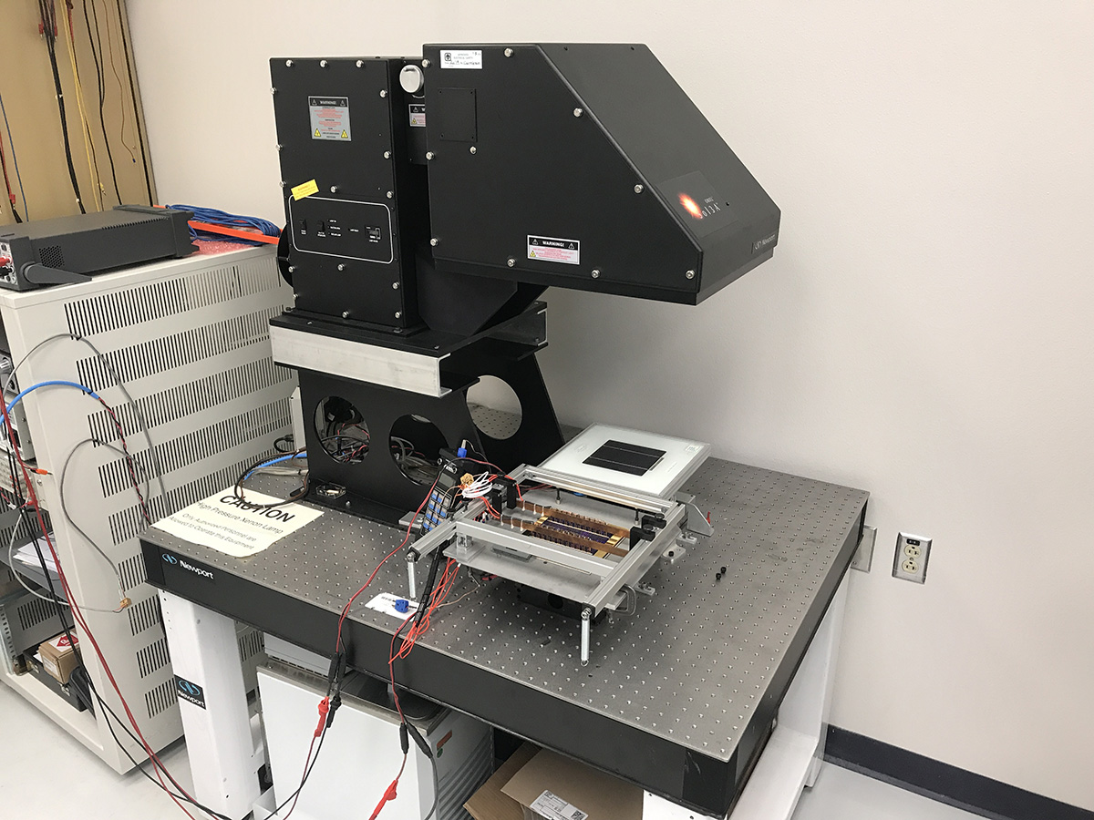
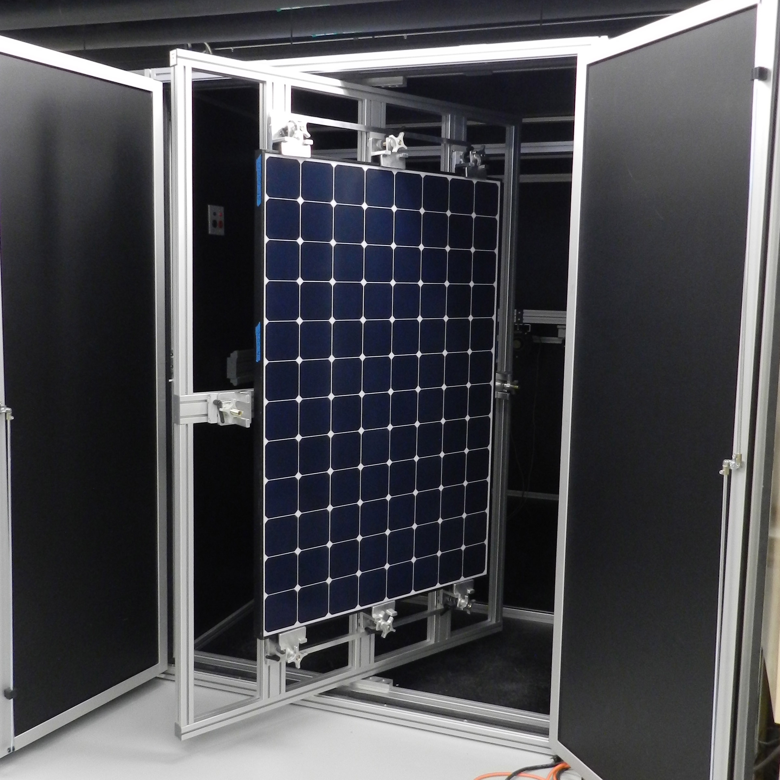
Cell, Module and System Characterization at the Photovoltaic Systems Evaluation Lab (PSEL)
Outdoor Module Characterization:
Systems and Component Reliability:
Dual Two-Axis Trackers
Characterize behavior under real-world operating conditions
Characterize a range of form factors from bare cells to mock roof sections
Facilitates performance model calibration
Types of Characterization
I-V Curves
Thermal Performance
Angle of Incidence
Instrumentation
Global and Diffuse POA irradiance
Comprehensive weather station nearby (including EKO spectroradiometers)
Purpose
1-month to multi-year installations
Validate energy yield calculations and system reliability
Evaluate materials and component reliability and degradation
System Monitoring
High frequency sampling of Voltage and Current, in situ IV sweeps
GPS time synchronized with other measurement platforms
Site Capacity
~ 5 acres dedicated to PV deployment
~ 750 kW grid interconnect
Indoor Module Lab:
Indoor Cell Lab:
1-Sun Flash Tester
Spire 4600SLP, Class AAA
Characterize IV behavior of modules as a function of irradiance
Monitored for long-term stability, supports reliability research
Custom Dark Room
Co-located Electro Luminescence, IR and UV Fluorescence Inspection Systems
Non-destructive module defect mapping
1-Sun Cell Tester
Oriel Sol-3 Class AAA light source
Characterize IV behavior of cells at various irradiance,temperature levels
Solar Cell Spectral Response
PV Measurements QEX10
Characterize electrical response of cells as a function of wavelength
Reflectance and Transmission
Cary 5000/DRA 2500
Characterize reflection and transmission of materials as a function of wavelength, orientation

Slide 3
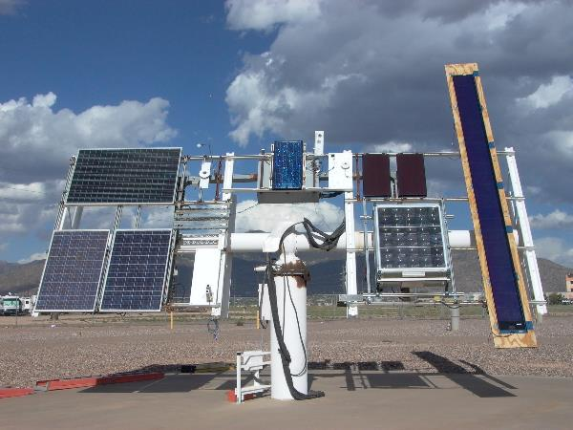
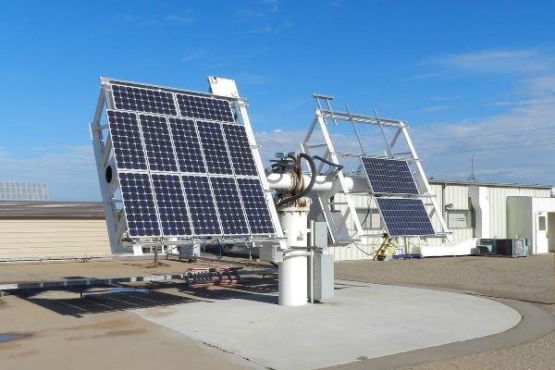
Outdoor Module Lab
Capabilities
Two fully programmable Two-Axis trackers
8 Data Channels (split between two trackers)
3m x 3m mounting area (per arm)
Range of Technologies
Flat plate (c-Si, CIGS, CdTe)
Concentrating Photovoltaics
BIPV
Bifacial
Single cells
Types of Characterization
I-V Curves
Thermal Performance
Angle of Incidence
Specialized tracker simulations (e.g. Horizontal Single-Axis)
On-board Instrumentation
Calibrated Silicon Reference Cell
Calibrated Pyranometers
Tracking Error Monitors
Module Backsheet Temperatures

Slide 4
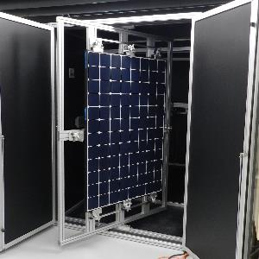
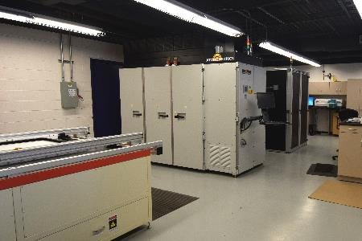
Indoor Module Lab
Solar Simulator
Spire 4600SLP
Characterize IV behavior of modules as a function of irradiance
Class AAA flash lamps
2m x 1.37m test plane
200-1100 W/m²
room temperature operation only
Module Inspection
Custom enclosure and module mounting
Max size: 2.1m x 1.4m module
Reltron PV Electroluminescence Inspection System
FLIR MWIR
24MP DSLR
Light-soaking/Pre-conditioning Chamber
Temperature controlled light-soaking chamber, integrated IV sweep capability

Slide 5
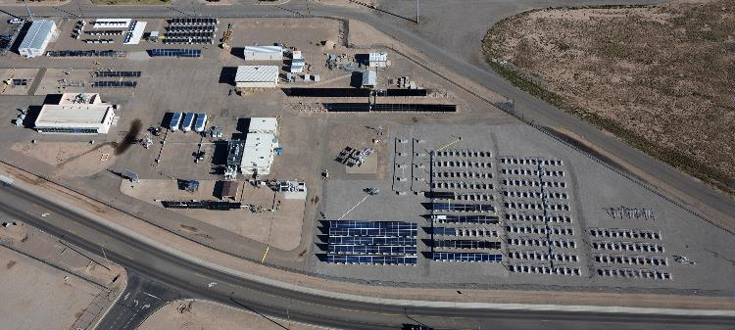
Systems Research
Purpose
Focus on Emerging Technologies
Minimum 1-year installations
Data used to validate energy yield calculations
Evaluate system reliability and degradation rates
Configuration and Capacity
750kW grid tie capacity
225 kW currently installed
100-125kW near term expansion (just need modules and inverters)
225-275kW mid term expansion (need site prep, racking, electrical runs)
Instrumentation
DC Voltage and Current (string and combiner)
AC Voltage, Current and Power Factor
Module Temperature
Local Irradiance Sensors
Other temperatures (e.g. inverter) as desired

Slide 6
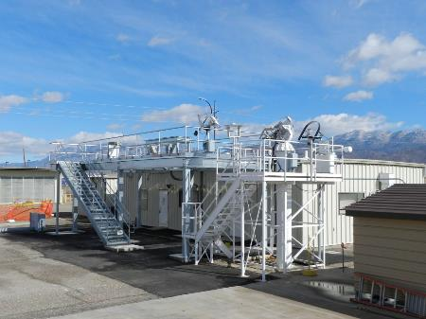
Solar Resource/Irradiance Network
Comprehensive Local Solar Resource Assessment
Irradiance
Spectrum
Other Environmental Parameters
Supports all outdoor measurement work (Module Testing, Systems Analysis)
1 minute data posted to Web real-time
Calibrations
Pyranometers
Reference Cells
~ 120 different instruments maintained, both locally and across RTC sites.
Weather Data is synchronized and merged with electrical measurement data for later analysis
http://photovoltaics.sandia.gov/weather/Weather.htm

Slide 7
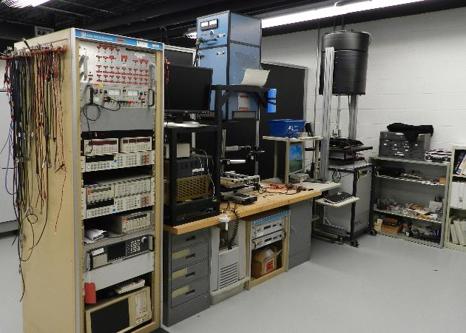
Component Lab
Equipment
SpectroLab XT-10 continuous solar simulator
Berger Pulsed solar simulator
PV Measurements QEX10 – quantum efficiency
Characterize electrical response of cells as a function of wavelength
Cary 5000/DRA 2500 Spectrometer
Mini-module fab
Small vacuum laminator
Stringer/tabber
Optical Microscopes
Ovens for component testing
Benchtop environmental chambers

Slide 8
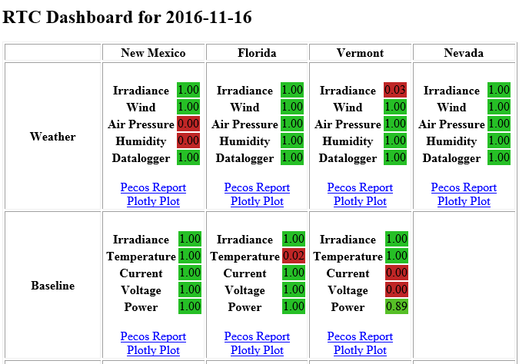
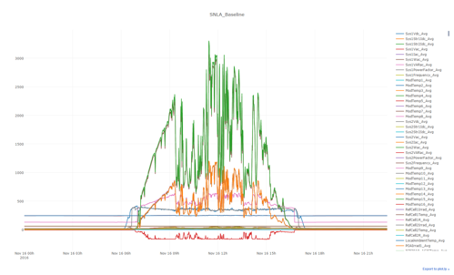
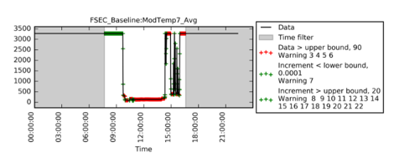
Data Management
Capabilities and Equipment
Database servers
Quality assurance of monitoring data from PV systems (daily)
Database development and maintenance
Public accessibility of data
Weather and system performance
Test item tracking and history
Matlab and Python analysis environment
Cellular networks for dataloggers
Data transfer from offsite systems

Slide 9
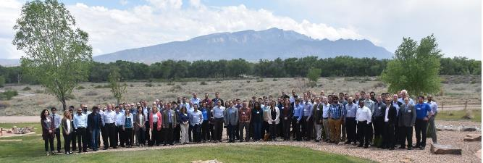
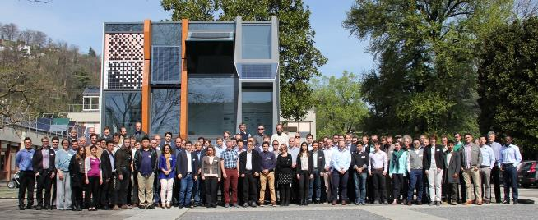
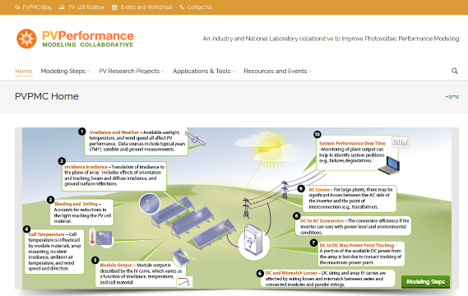
Communications / Stakeholder Outreach
PV Performance Modeling Collaborative (PVPMC)
2,800 member mailing list
Website with over 10,000 hits each month
PVLIB for Matlab and Python
Over 50 open source functions for PV performance modeling
Extended Series of Workshops (14th currently planned)
International (USA, Germany, Switzerland, China)
Over 200 past presentations available on website.
International Energy Agency PVPS Task 13
Three-year work plan began in late FY18

Slide 10
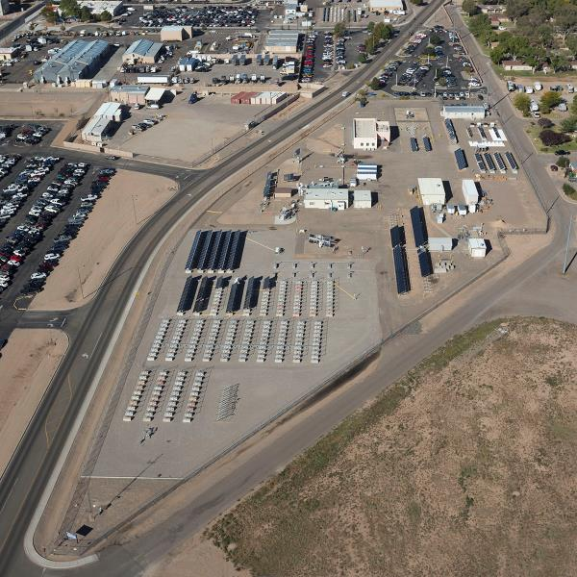
Infrastructure and Site Operations
Site Description
7-acre fenced site located on Kirtland Air Force Base
750 kW grid tie capacity, two transformers
7 Buildings; office, lab, R&D and shop
Operations
Site safety and training
8 Tech Staff, 2 Students
Site specific Safety
Vehicles
Forklift, scissor lift, electric cart for material movement
6 storage trailers
Light Machine shop
End mill, lathe, band saws, hand tools
Research Capabilities
Module characterization, indoors and outdoors
Fixed tilt PV systems
CPV Tracking Systems
Components durability
PV Technology Agnostic

