Slide 1
DOE / SNL Scaled Wind Farm Technology (SWiFT) Facility at TTU swift.sandia.gov
Dr. Jonathan R. White
World-Class Wind Testing Facilities
Wind Energy Technology Department
Sandia National Laboratories
(505) 284-5400 jonwhit@sandia.gov

Slide 2
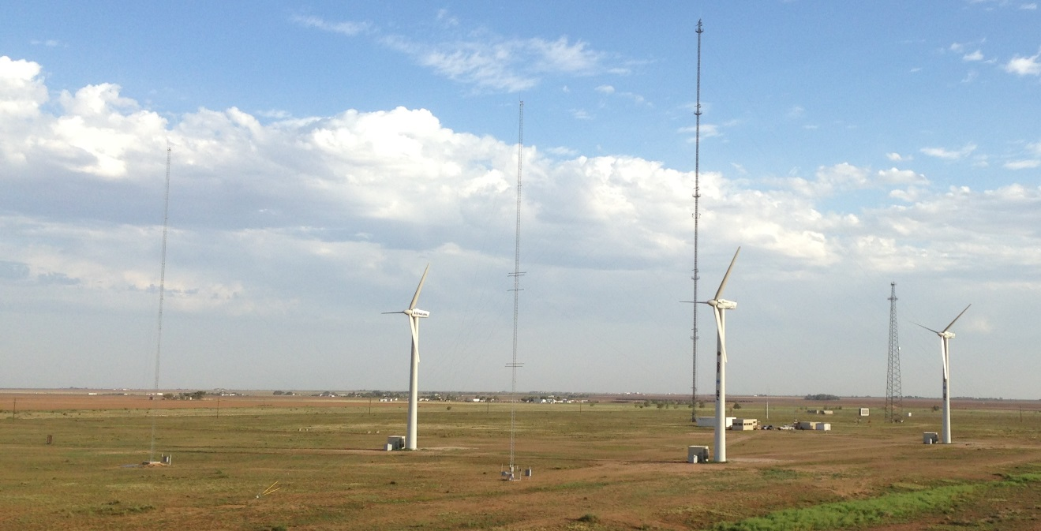
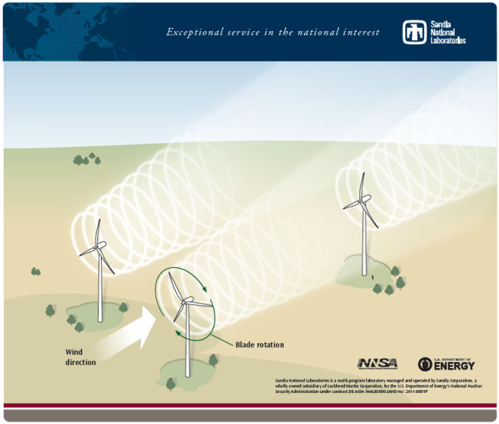
SWiFT Facility
SWiFT exists to:
Reduce turbine-turbine interaction and wind plant underperformance
Develop advanced wind turbine rotors
Public open-source to advance simulation capabilities
Facilities:
Three variable-speed variable-pitch modified wind turbines with full power conversion and extensive sensor suite
Two heavily instrumented inflow anemometer towers
Site-wide time-synchronized data collection

Slide 3
Outline
What is the SWiFT Facility?
What research projects use SWiFT?
How can I use SWiFT?

Slide 4
Outline
What is the SWiFT Facility?
What research projects use SWiFT?
How can I use SWiFT?

Slide 5
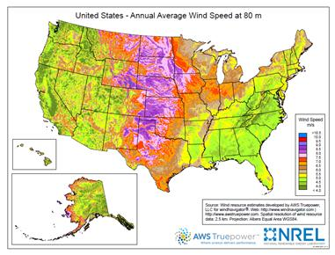
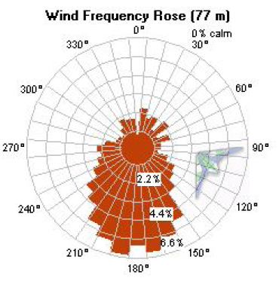

Location, Location, … Location
7.5 m/s at 50 m,
Class 5 Wind Site!
Consistent South Wind, 180.5°Average

Slide 6
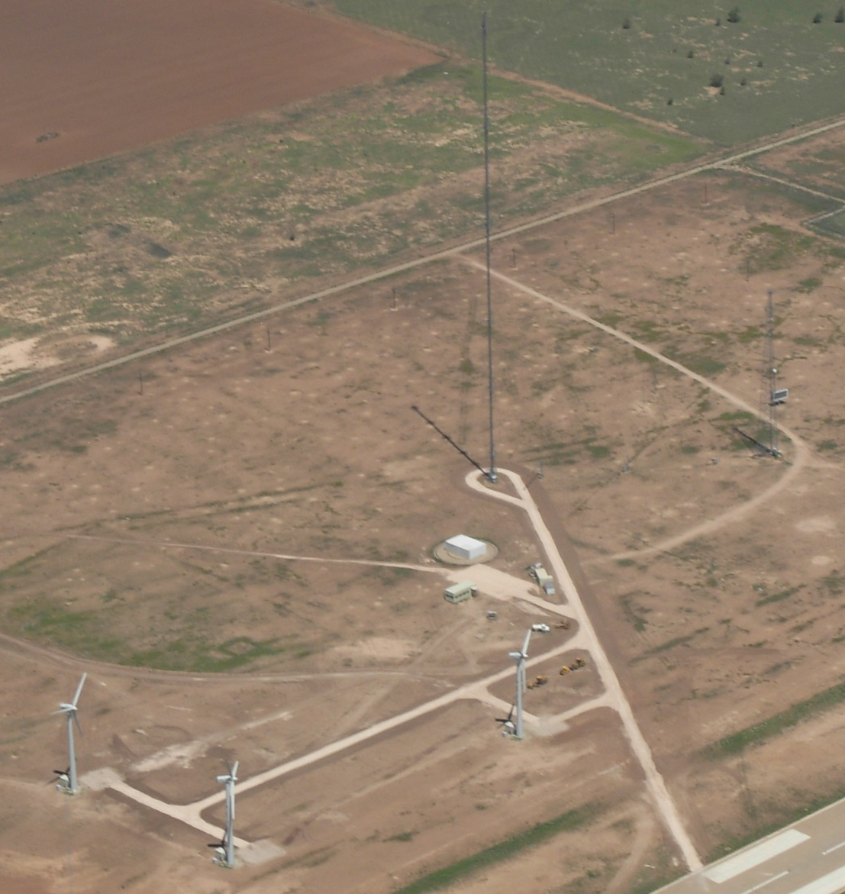
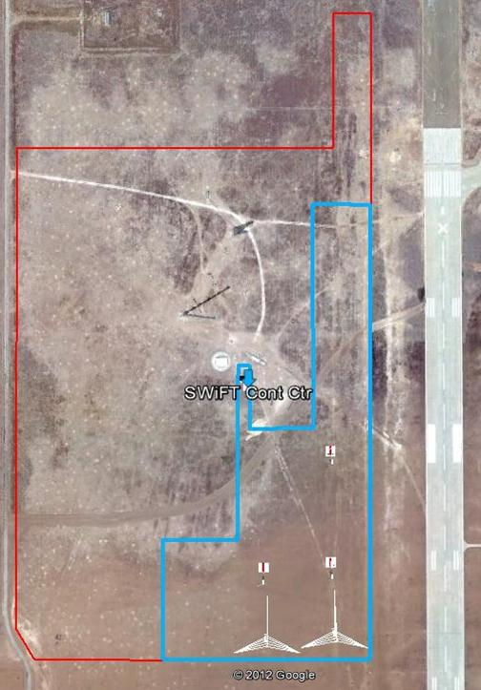
Layout
DOE/SNL
SWIFT
Facility

Slide 7
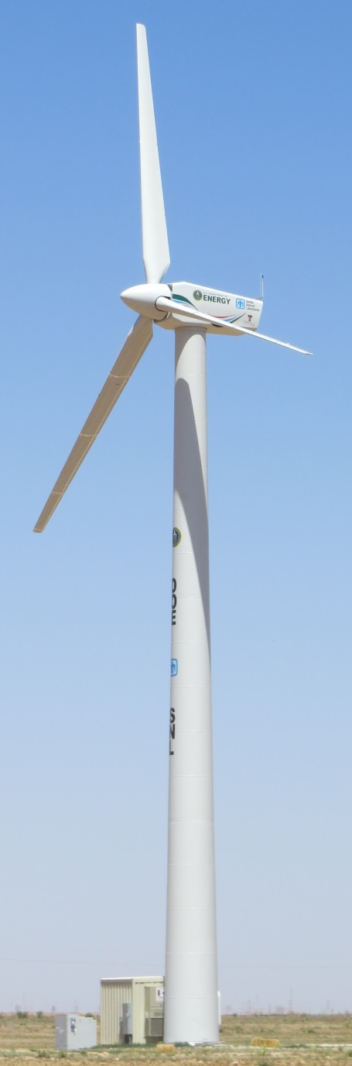
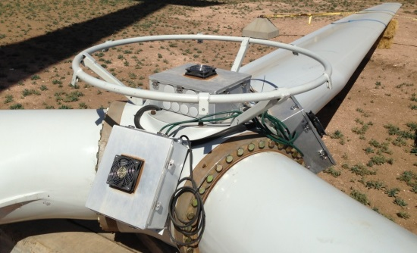
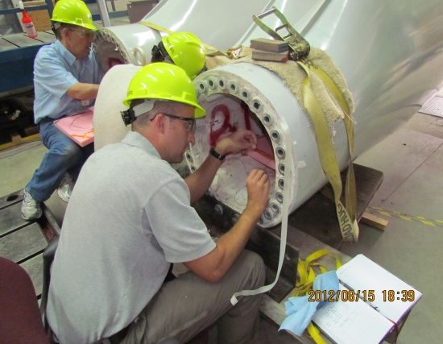
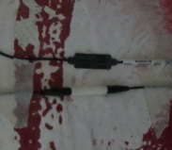
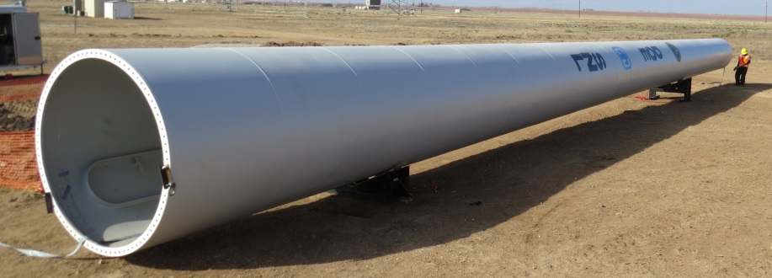
SWiFT Wind Turbines
Hardware
Collective Pitch System
300 kW Variable Speed Generator
AC-DC-AC Full Scale Convertor
National Instruments controllers
Complete turbine / rotor state instrumentation
Fiber Optic blade sensing system

Slide 8
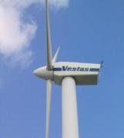
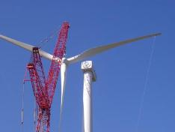
Why this size?
Research-Scale
Megawatt-Scale
Minimum research
cost and time
Exact Scaling
A cost-efficient size for which research can be directly scaled to larger, more costly and time-consuming sizes.
Requirements:
  Operation at Reynolds Number (scaling parameter) between 10⁶ and 10⁷
  Tip speeds approaching 80 m/s for acoustics and large rotor projects
  Variable-speed variable-pitch operation
  Minimal cost and time associated with research operations
  Highly reliable turbine
  Minimal restrictions on publication and intellectual property

Slide 9
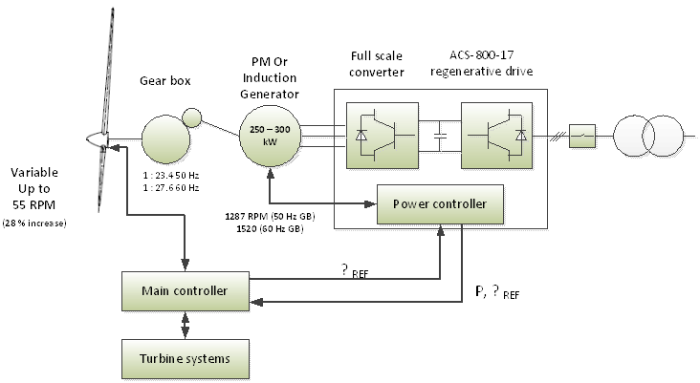
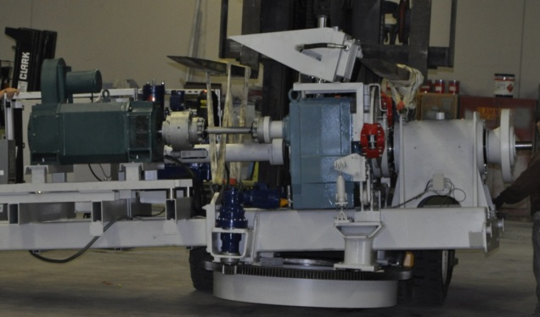
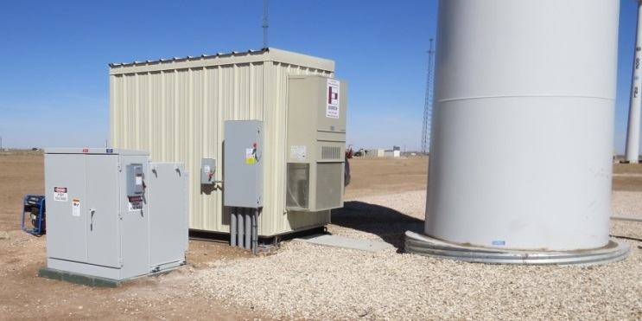
SWiFT Wind Turbines
Control Software
Open Source Code
Modularized by Subsystem
EtherCAT up to 1000 Hz
All DAQ signals available for control
Running on NI Veristand
Parameterized Variable Speed and Torque Controller
Maintains all original safety systems and alarms

Slide 10
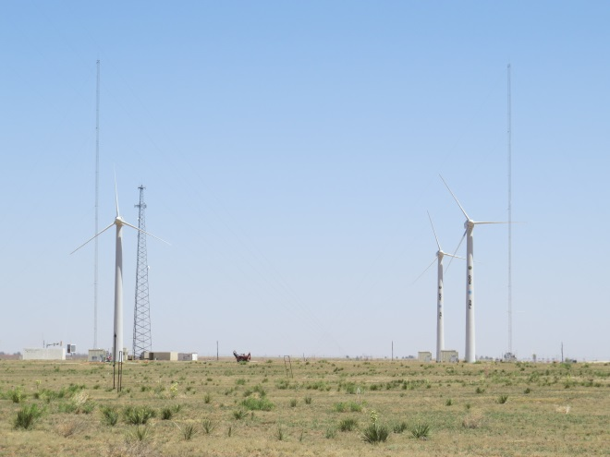
Inflow Characterization

Slide 11
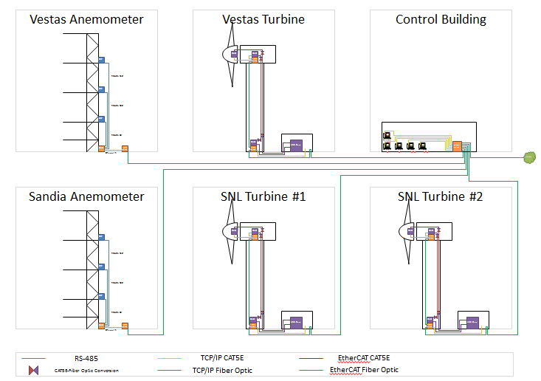
Networking Infrastructure
GPS synced measurements
Up to 1000 Hz
Currently 500+ channels
Centrally logged data
Fiber optic data transfer
Localized deterministic control loops

Slide 12
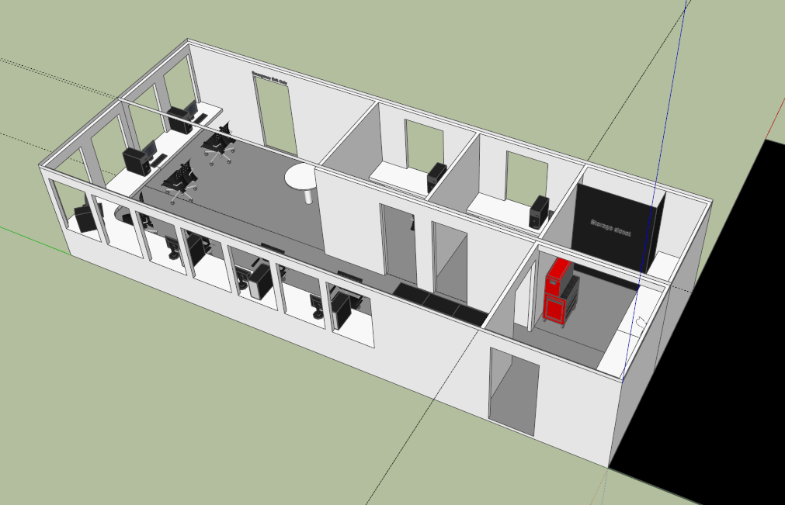
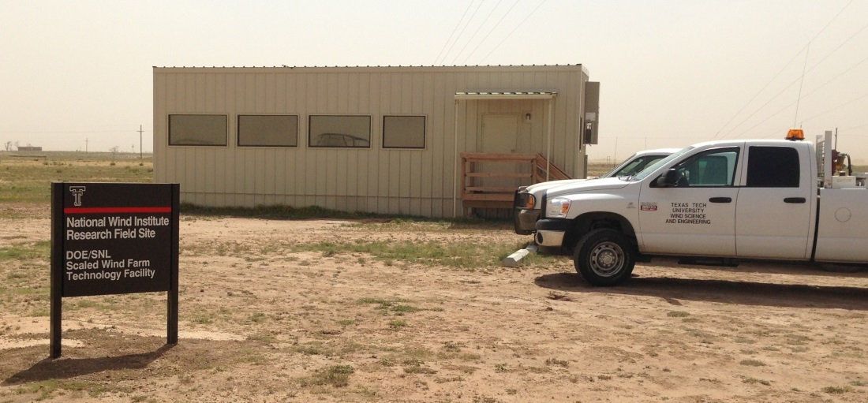
Control Building
Central control and operations
700 sq. ft. with 2 temporary offices for proprietary work
Electrical troubleshooting lab

Slide 13
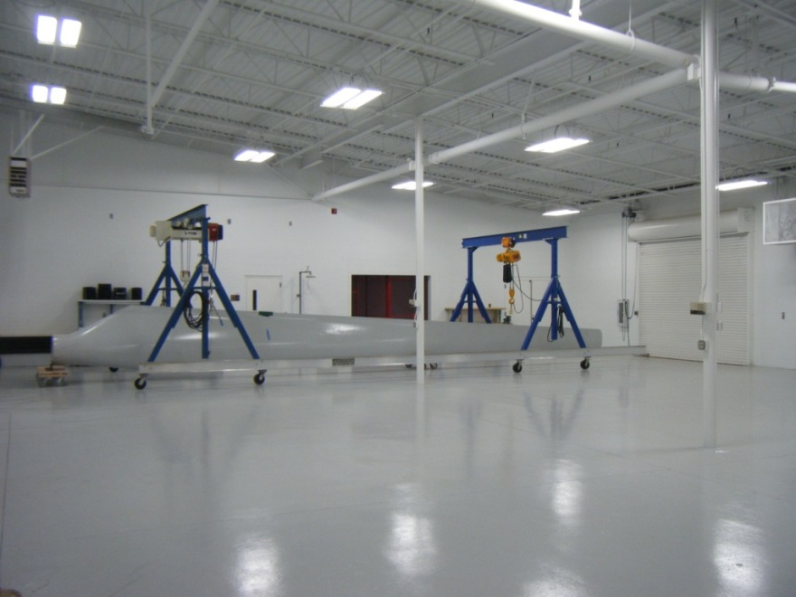
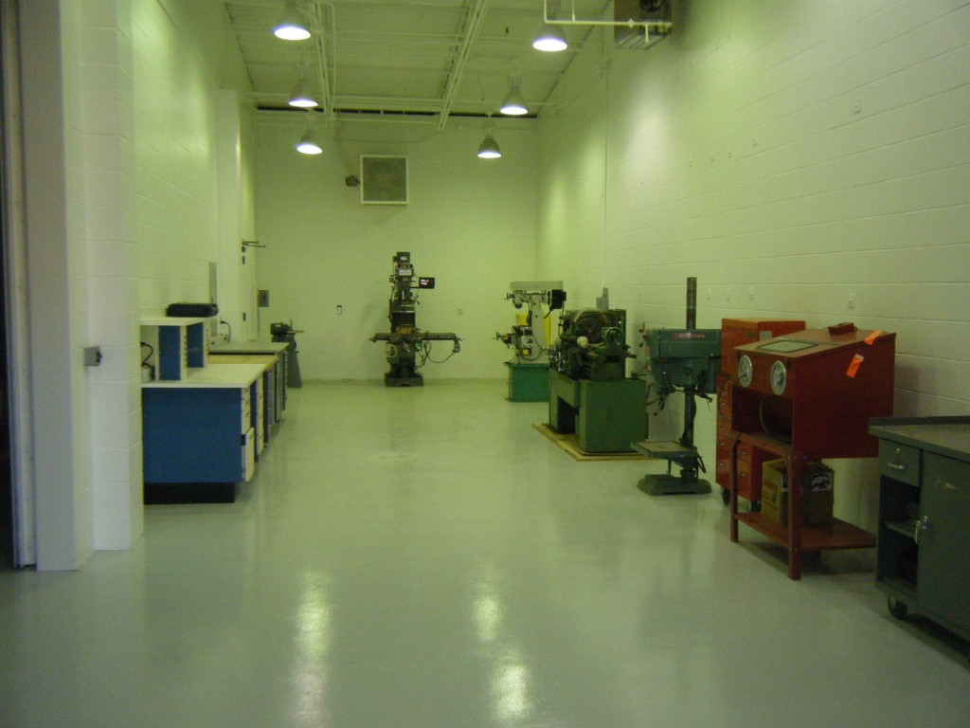
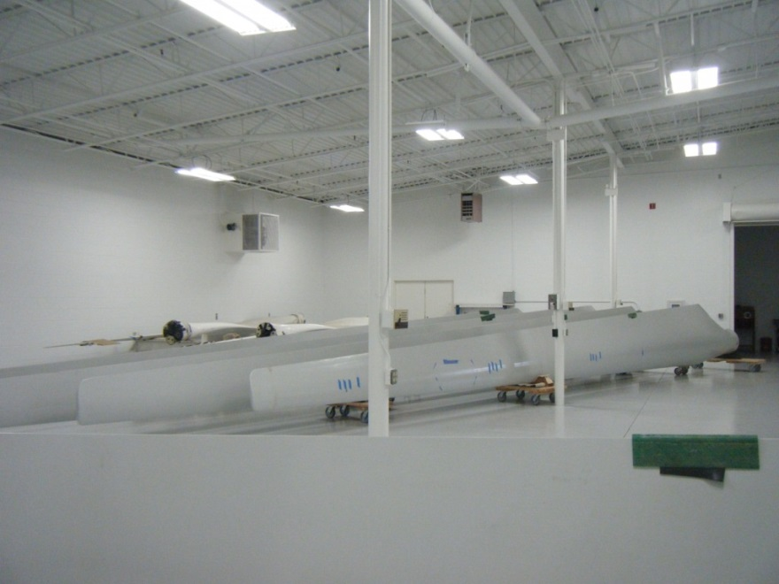
Experimental Preparation Lab
4,500 sq. ft. environmentally controlled high-bay experimental rotor preparation
1,000 sq. ft. machine shop

Slide 14
Outline
What is the SWiFT Facility?
What research projects use SWiFT?
How can I use SWiFT?

Slide 15
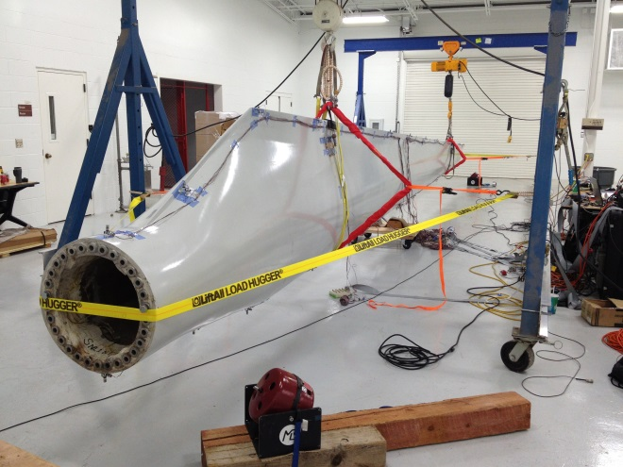
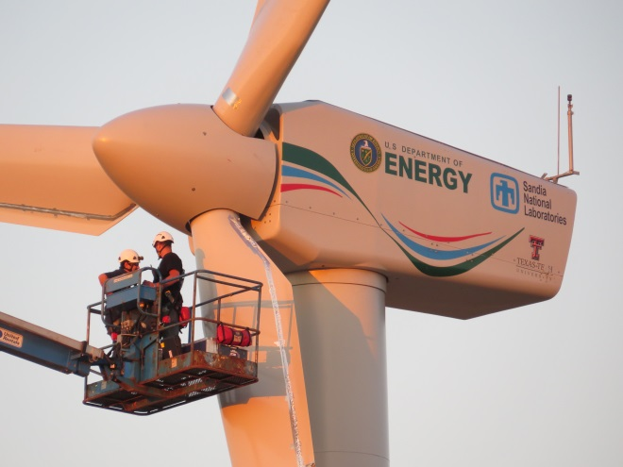
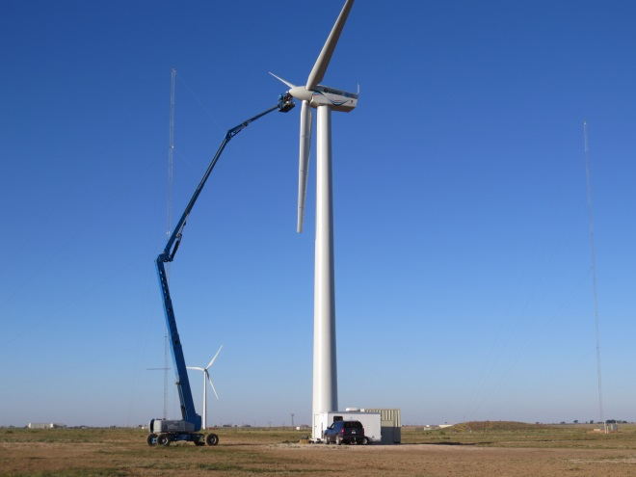
SWiFT Baselining
Detailed analysis of fundamental turbine-turbine interaction
Calibration and verification of public open-source wind turbine / plant model
Data quality analysis and troubleshooting

Slide 16
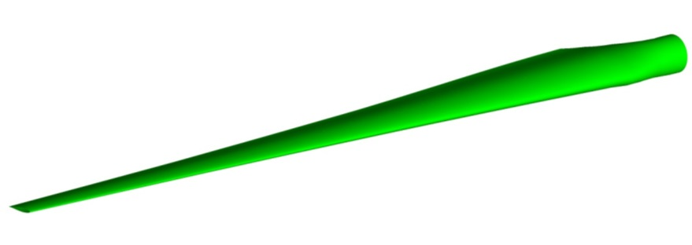
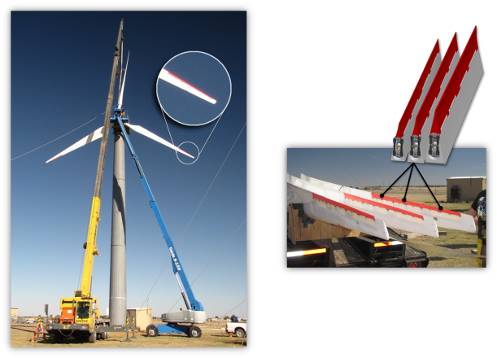
National Rotor Testbed
The National Rotor Testbed is a
rotor innovation to enable
technology acceleration
Baseline blades represent
functionally scaled-down aerodynamics and structural dynamics of a modern megawatt-scale rotor
Baseline blade design is public and open
Enables research in: wake interactions, aero-acoustics, inboard aerodynamics, controls, aeroelastic dynamics

Slide 17
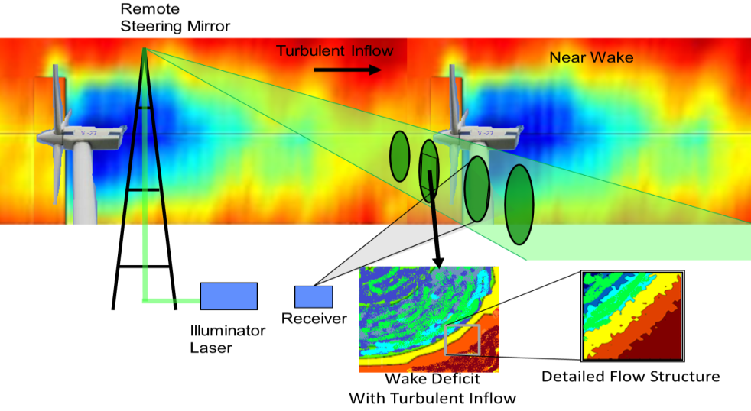
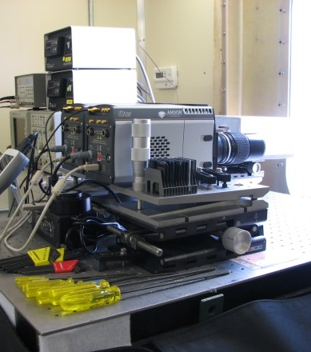
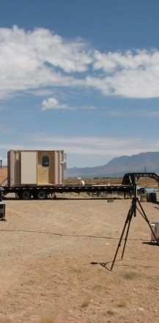
Wake Imaging
Measurement System
Capture detailed 3-D flow structures that convect downwind
High spatial resolution: 16,000 data points per sample
Imaging allows for fast scanning sufficient to capture sub-rotor scale turbulent flow structures
Enables direct comparison with high-fidelity and engineering level models

Slide 18
Future SWIFT
Research Ideas
Partnership opportunities:
  Rotor design for wind plant (wake reduction)
  Quiet rotor design
  Active / passive load control
  CM and SHM validation testbed
  Blade repair validation rotors
  Stealth rotor
  Advanced materials rotor testing
  Component field testing (sensors, blades, controllers, etc.)
  Land-based offshore simulator

Slide 19
Outline
What is the SWiFT Facility?
What research projects use SWiFT?
How can I use SWiFT?

Slide 20
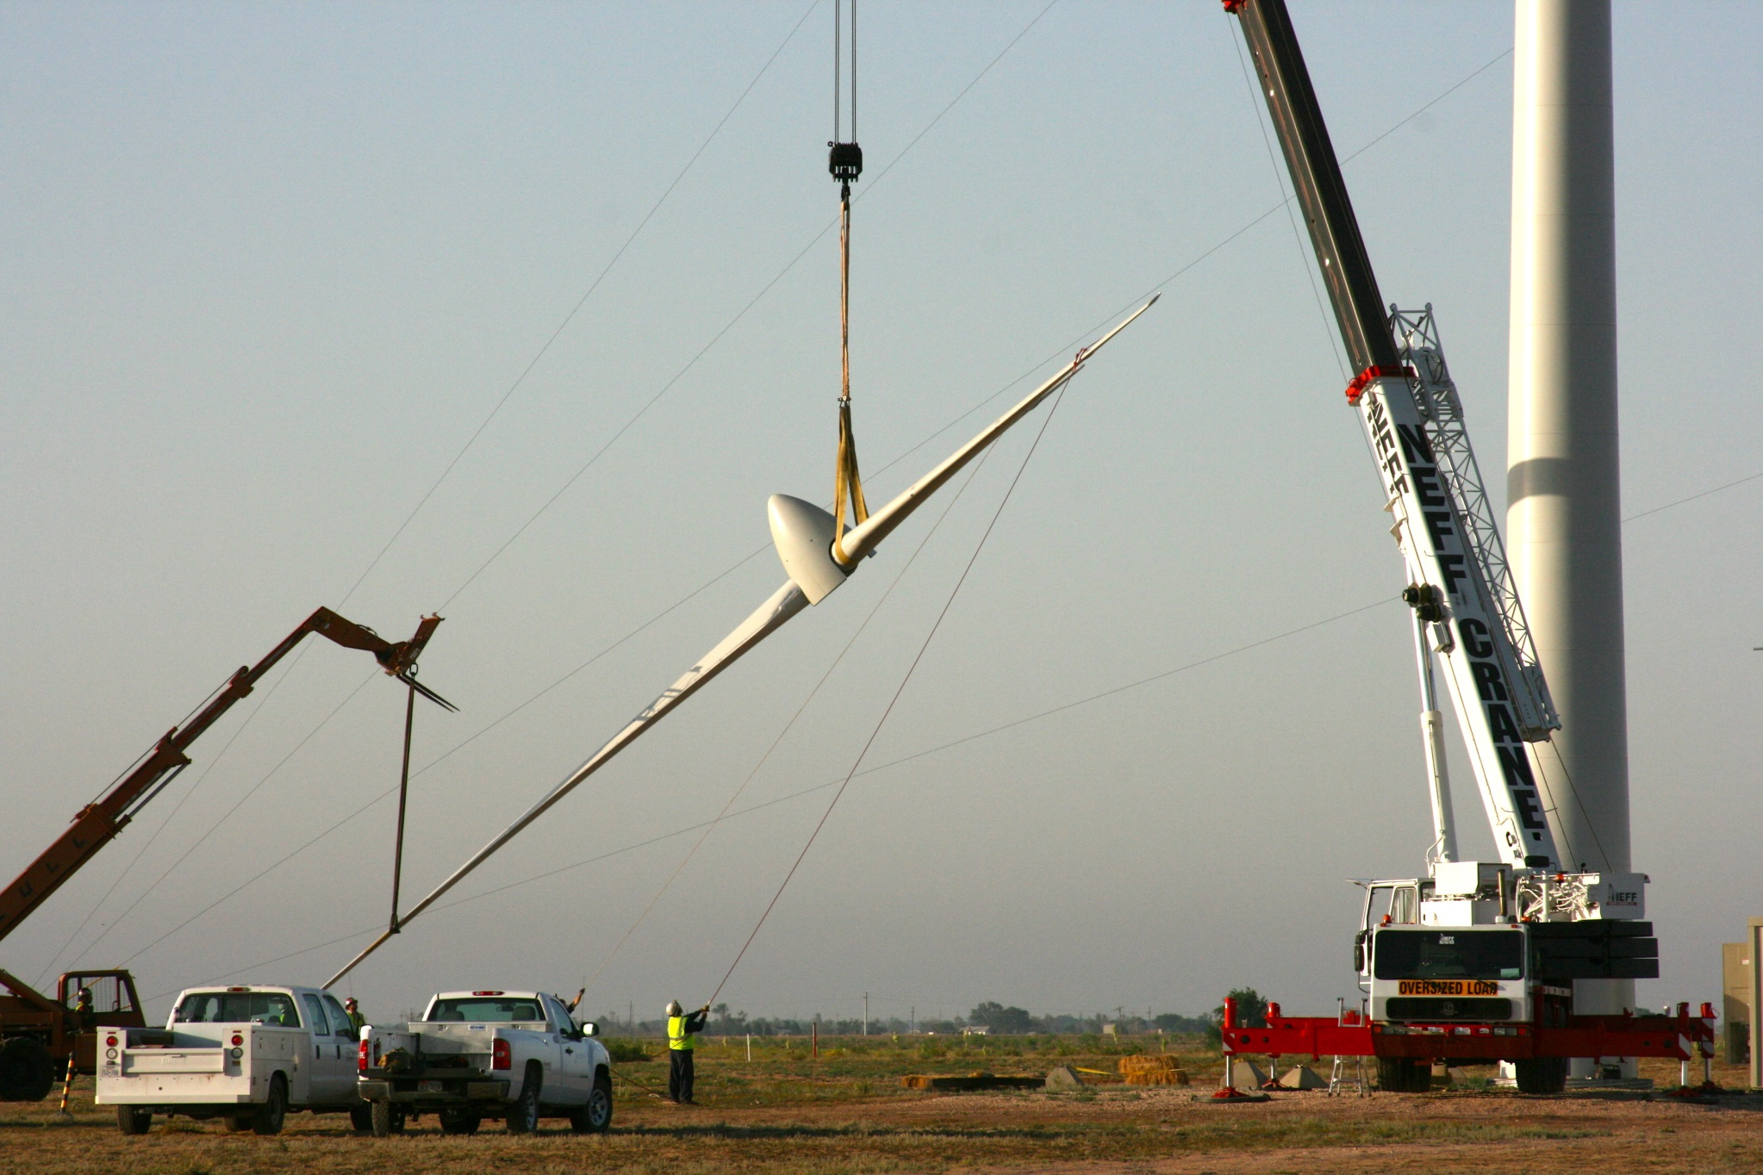
How to partner
SWiFT is open to all partnership opportunities:
  Partners include industry, academia, laboratories, etc.
  Facility has been designed to minimize research cost
  Public, public / proprietary and solely proprietary all possible
  Partnership agreements include:
    Work For Others (WFO)
    Collaborative Research and Development (CRADA)
    Memorandum of Understanding (MOU)
    Joint Funding Opportunities (FOA)

Slide 21
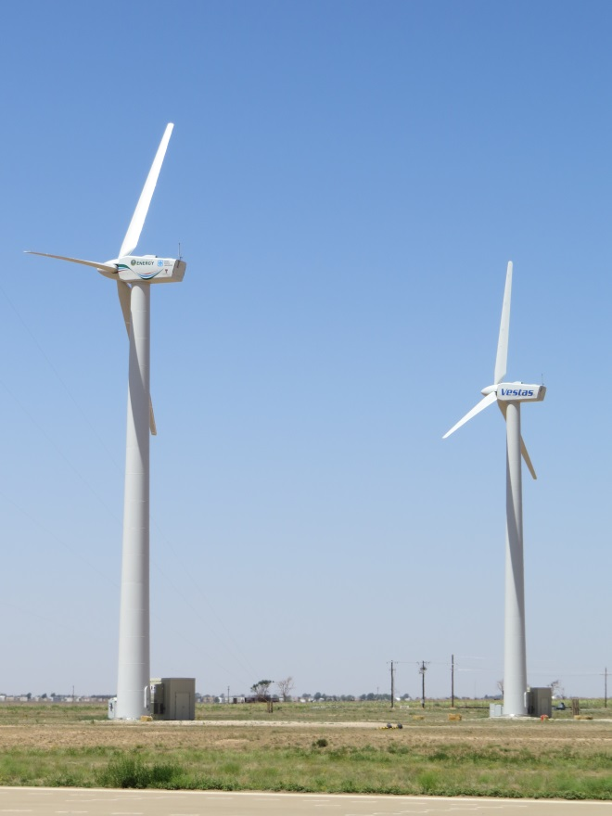



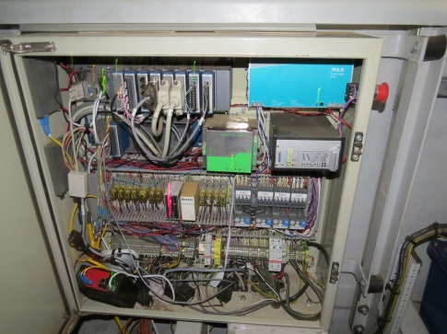


Partnership Examples
Vestas installed a turbine owned by Vestas and managed by Sandia as a technology accelerator for their product development (rotors, acoustics, wind plant control)
National Instruments is co-developing cRIO hardware and Veristand software for distributed control
ABB is using power electronics equipment to improve wind market products

Slide 22
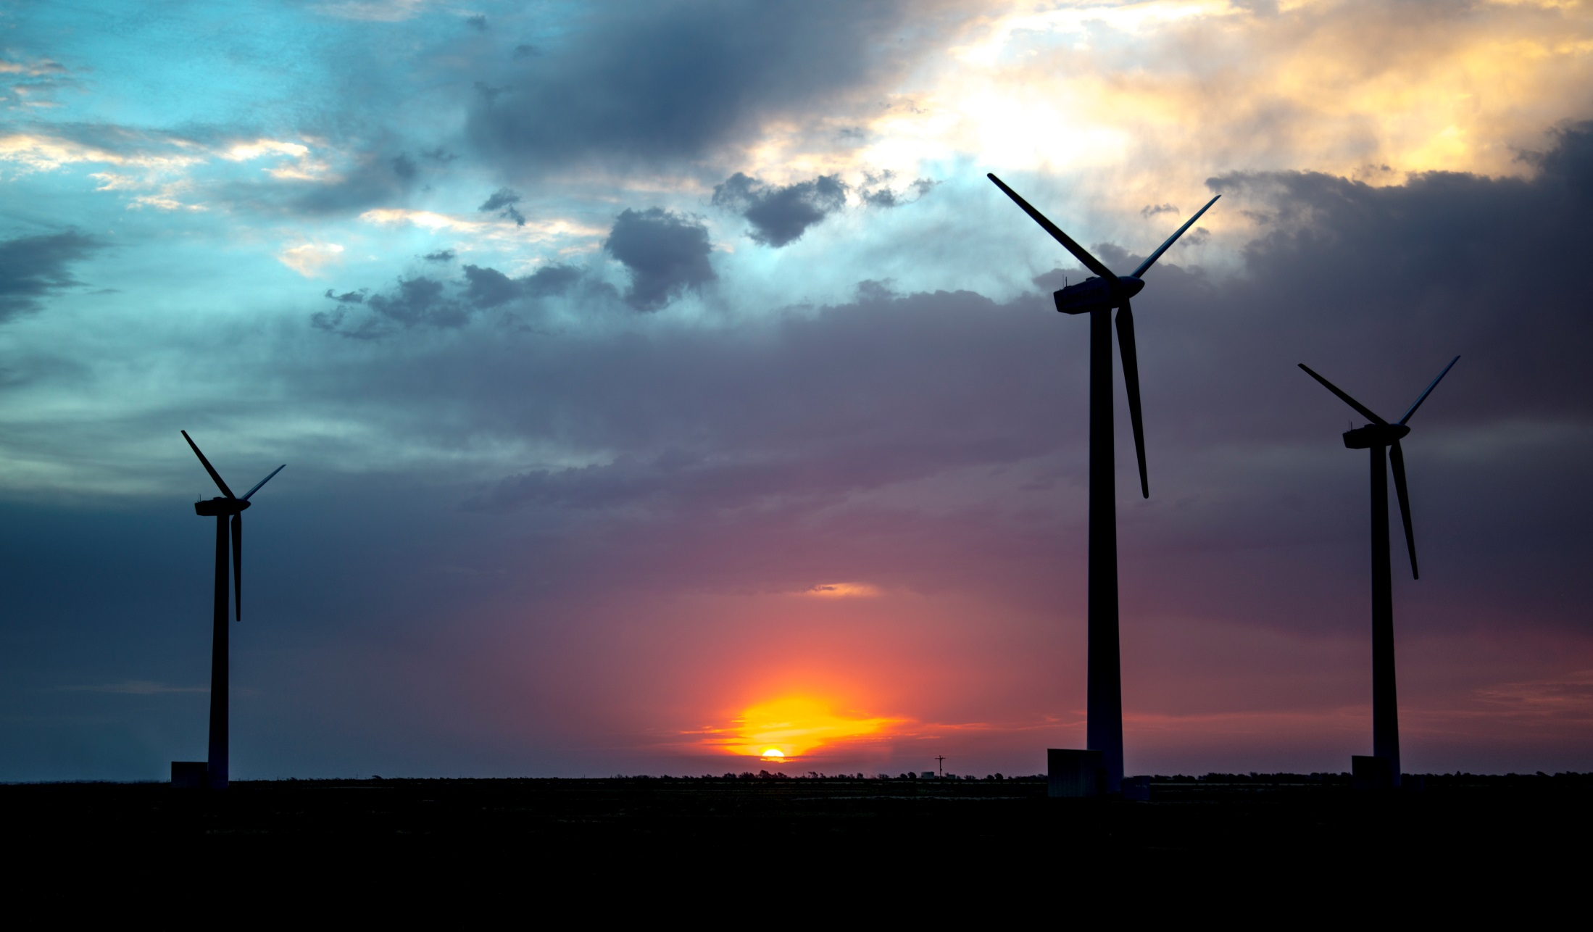
Thank you!

Slide 23
Backup Slides

Slide 24
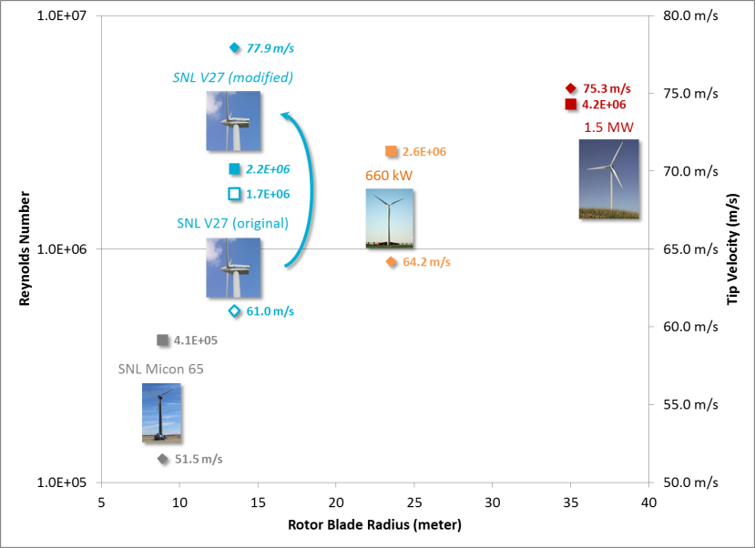
Aerodynamic Scaling

Slide 25
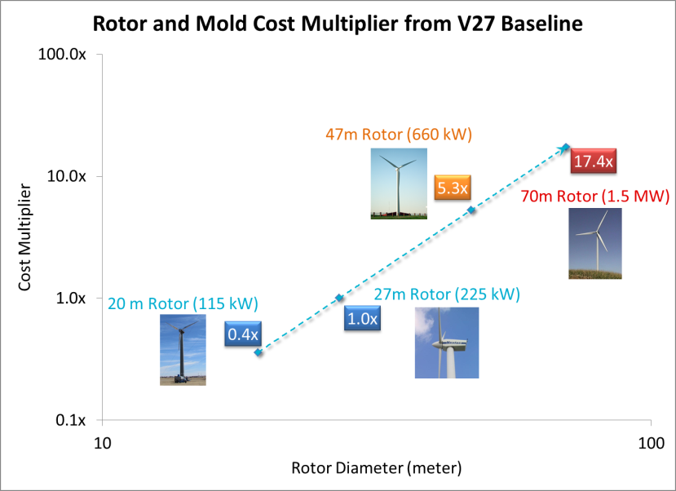
Cost Efficiency

Slide 26
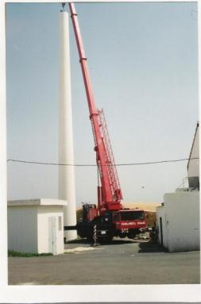
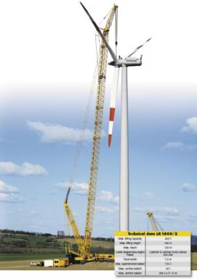
Crane Cost Comparison
Research Scale (225 kW)
Megawatt Scale
Costs
$5,000
v.
$250,000
Scheduling
Days
Ahead
Months
Ahead
v.
Testing Risk
Low
v.
High

Slide 27
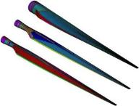
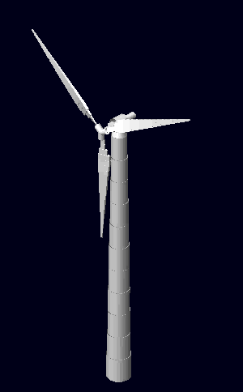


National Open-Source Research Asset
DOE / SNL Rotor Blade Designs
DOE / SNL
FAST / ADAMS
Model of V27
Feasibility Proof
Technology Demonstration
Commercialization
TRL-1
TRL-2
TRL-3
TRL-4
TRL-5
TRL-6
TRL-7
TRL-8
TRL-9
Basic Research
Technology Development
Sub-Scale Testing
DOE / SNL
SWIFT
Facility
at TTU
DOE / SNL Advanced Blade
Testing at NREL-NWTC

Slide 28






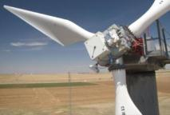


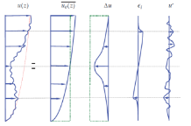
Research-Scale
Examples of Success
“Light detection and ranging measurements of wake dynamic Part I & II” 2011
CX / TX / BSDS Blade Family Study
LIDAR Scanning of 95 kW Turbine Wake
Fabrication and Testing at the 115 kW Scale
Decomposition of Wake Deficit
Result: 24% reduction in damage equivalent load and initiated industrial use of carbon, flatback airfoils and twist-bend coupling.

Slide 29
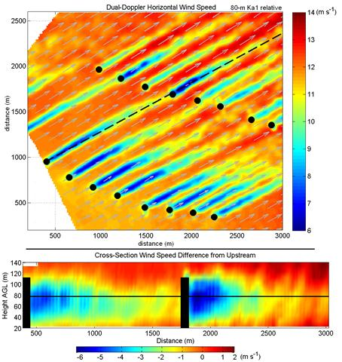
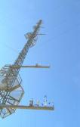
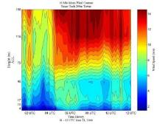
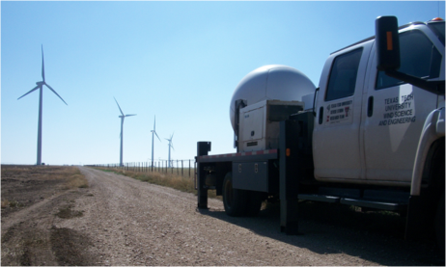
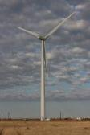
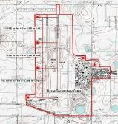
DOE/SNL/TTU Partnership
Wind Science and Engineering Research Center (WISE) has a 40 year history in wind-related research and development
Unique Capabilities and Facilities
Distributed Wind Resource Assessment
Large-scale Test Infrastructure
2x mobile Doppler research radars
200 meter anemometer tower
MW Wind Turbines

Slide 30




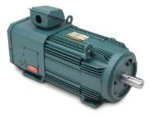

Variable-Speed Upgrade
Fixed
Speed
DOE/SNL
Variable
Speed
(Open-source)

Slide 31

Re-purposed
Assembly Building

Slide 32




Site Construction

Slide 33


SWiFT

Slide 34


Anemometer Tower

Slide 35

SWIFT Array Long-Term Plan
Phase 1
Vestas Turbine
Phase 1
DOE/SNL Turbines

Slide 36

SWIFT Array Long-Term Plan
Phase 2

Slide 37

SWIFT Array Long-Term Plan
Phase 3

Slide 38

SWIFT Array Long-Term Plan
Phase 4

